Slide 1
Portfolio Executive Committee (PEC)
Review Meeting
Portfolio Overview Update - Inflammation
Yuting Li/Ying Chen Apr 25th , 2024
25mins
CONFIDENTIAL and for INTERNAL use only!

Slide 2
One Page Summary-----Inflammation
TA priority assets： Spesolimab, Catci;
cGAS inhibitor, PD-1 agonist
Interferonopathy:干扰素病
PG: pyoderma gangrenosum坏疽性脓皮病
TA | Ongoing |  | Endorsed | Under Evaluation | Next wave
Inflammation | Spesolimab GPP EAP （1368.77） |  |  | BI 3032950 (TREM-1 Antagonist) / IBD；CD；UC-Ph2b | BI 765250 (PD-1 agonist) / SSc
 | Spesolimab GPP (1368.25) |  |  | BI1291583 (CatC inh) nCF Bronchiectasis | BI 1819479 (Autotaxin Inhibitor) /SSc
 | Nintedanib (TKI) PF-ILD CN PAC - Ph3b (1199.434) |  |  | BI 3000202 (cGAS inh.) Interferonopathy | BI765423 (Anti-IL11 mAb) IPF/PPF
 | Spesolimab/Netherton Syndrome-Ph2/3 (1368.104) |  |  |  | BI 3000202 (cGAS inh.) SSc
 | Nerandomilast(PDE4b inhibitor)/ IPF Ph3 (1305.14) |  |  |  | BI 3009947 (STING inh.) SSc
 | Nerandomilast (PDE4b inhibitor)/ PPF Ph3 (1305.23) |  |  |  | BI 3720931 (GTC) (LV gene therapy) CF
 | BI 706321 (RIPK2 inhibitor) /CD-Ph2b (1425.4) |  |  |  | BI 3731579 (NOX4 inh.) IPF
 | Avenciguat(sGC activator)/ SSc- ph2 (1366.31) |  |  |  | BI 3009947 (STING inh.) Interferonopathy
 | Spesolimab/Hidradenitis suppurativa -Ph2/3（1368.98） |  |  |  | BI 3810477 (anti-CTGF) in IPF/PPF
 | Sepsolimab GPP Post marketing requriement (1368.120 ) (GPP flare retreatment) |  |  |  | BI 1015550 (PDE4b inhibitor)/ SSc
 | BI 1839100 (TRPA1 antagonist) IPF/PPF cough ph2 (1490.4)
 | Spesolimab (PG) ph3 (1368-0140)
 | BI 1819479 (Autotaxin inhibitor) IPF/PPF ph2 (1462.4)
Timeline: 1-3 months delay or potential delay;
Strategic issue: global strategy uncertain; China integration/development at risk, insufficient China sample size;
Operational issue: slow enrollment, retention rate lower than plan;
Regulatory issue: technical and/or dossier issues and/or deficiency letter with potential impact to approval and/or approval timeline;
Quality: 3 major site audit observations, inspection readiness with significant issues; major NC report
Timeline: > 3 months delay
Strategic issue: project to be terminated, China integration/development undermined;
Operational issue: major enrollment delay, significantly poor retention;
Regulatory issue: negative comment from authority, major concerns due to regulation change;
Not meeting primary end point;
Quality: ≥ 1 critical and/or ≥ 4 major site audit observations; inspection readiness with critical issues; critical NC report
Green font: Updates from last PEC
Blue font: Not covered in following detailed updates
On track
Notes:
Peresolimab PoC

Slide 3
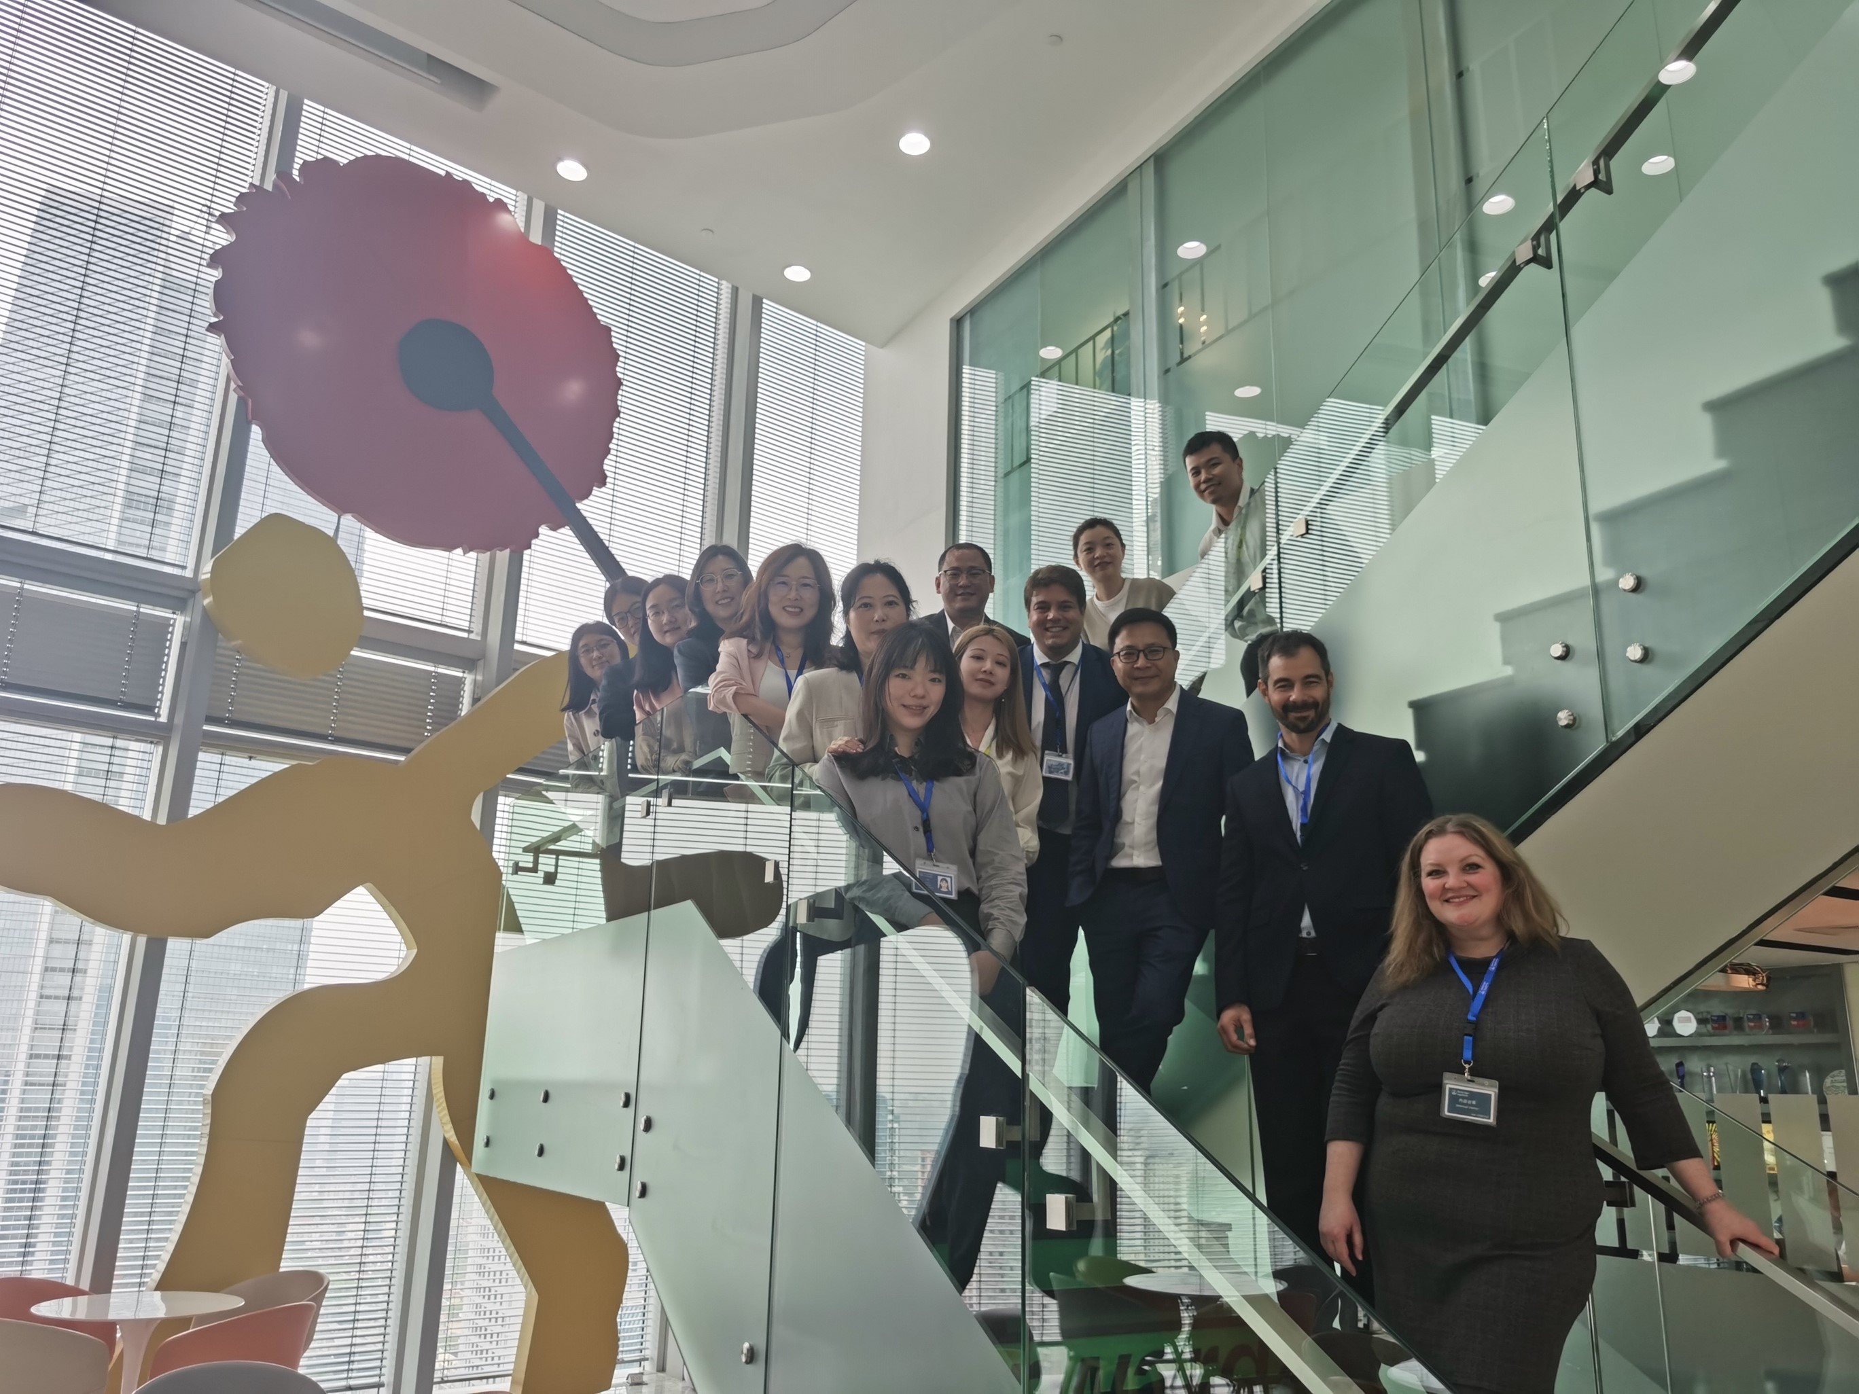
Nerandomilast Asset Team China Visit Workshop on Feb 22nd
Asset team members (Asset lead, value lead and sPM) discussed with China team on evidence generation and launch preparation topics.
Further deep dive with evidence team on Apr 29 regarding
    China joining CTD-ILD and Pediatric program
    Global support to meet local registration timeline

Slide 4




Ongoing: Nerandomilast (PDE4b inhibitor)
Idiopathic Pulmonary Fibrosis(IPF) and Progressive Fibrosing Interstitial Lung Disease(PF-ILD) (Ph3)
2022 |  |  |  | 2023 |  |  |  | 2024 |  |  |  | 2025 |  |  |  | 2026 |  |  |  | 2027
Q1 | Q2 | Q3 | Q4 | Q1 | Q2 | Q3 | Q4 | Q1 | Q2 | Q3 | Q4 | Q1 | Q2 | Q3 | Q4 | Q1 | Q2 | Q3 | Q4 | Q1
We are here
Ph3-1305.14
Sep 26
5Jun 2023
Aug 2024
IPF N=1077
US NDA Sub
Jan 2025
US NDA appr.
Sep 2025 – Jan 2026
FSS
LSS
Last patient Primary
endpoint
Ph3-1305.23
Nov 8
1Nov2023
Dec 2024
US NDA Sub
May 2025
US NDA appr.
Jan – May 2026
PF-ILD N=1078
Ph3 OLE-
1305.31
Last patient Primary
endpoint
Sep 2024
Jan 2027
Ph3 OLE
FSS
LSC
China
Jul2022
Dec2022
Feb2025
Feb 2026(best case), May 2026 (base case)
Ph3-
1305.14
CTA Review + EC + HGRAC + 1st SIV (5.5 M)
CN ML N=97
TW: N=22
NDA review for IPF
CTA Sub
NDA Sub
NDA App
Jun 2025
Apr 2026 (best case)
Jun 2026(base case)
Ph3-
1305.23
CTA Review + EC + HGRAC + 1st SIV (5.5 M)
Allocated China ML N=155, TW: N=28
NDA review for PPF
CTA Sub
1st SIV
Sep 2024
NDA Sub
NDA App
Jan 2027
Sep 2023
CTA Review + EC + HGRAC + 1st SIV
Ph3 OLE-
1305.31
FSS
LSC
China PK 1305.24
13 Jan 2023
17Mar2023
14Jul2023
Jan 2024
Considering benefit of BTD for market access, team preliminarily aligned to apply for BTD if Ph3 data is promising.
CAPA for for-cause audit at CHN1 site under development, to be finalized by end Apr
LSS: Last subject screening
LSLV: Last subject last visit
DBL: database lock
HAI: Healthy authority interaction
OLE: Open label extension
CAPA: Corrective and Prevention Action
BTD: Breakthrough designation
CTA Review + EC + HGRAC (6M)
CN PK
CTA Sub
SIV
LPO
DBL
CTR
Notes:
1. For BE study, two studies are planned (9 mg, 18 mg). There might be update in the middle of this year. Team will closely monitor the update.

Slide 5
Nerandomilast (PDE4b inhibitor) Trial Update –15Apr2024
FIBRONEER |  | Global | China mainland | Taiwan​
Fibroneer-IPF 1305.14 | Total Screening | 1720+16 rescreen | 168+1 rescreen | 41​
 | Total randomized | 1177 | 97 | 22​
 | Early discontinuation | 169→174 (14%) | 17→17(18%) | 2, 9%​
Fibroneer-ILD 1305.23 | Total Screening | 1785 | 251 | 37​
 | Total randomized | 1178 | 155 | 28​
 | Early discontinuation | 136→141 (12%) | 20→ 23 (15%) | 1→2 (8%)​
FIBRONEER-ON: EC preparation and site initiation is on track.
Notes:
CTD-ILD study will generate evidence to help address 2 prioritized gaps: Data for rheumatologists, and impact of immunosuppressants on efficacy and safety.
Data on combination therapy with immunosuppressants (IS) is needed to bridge the evidence gap and support the BI 1015550 in PPF.​
​
The main objective of the CTD-ILD study is evidence generation for safety.​
​
Results will support the PPF indication and address the evidence gap for rheumatologists, helping to meet the current forecast.

Slide 6
Fibroneer : Ranking Related to Permanent Discontinuations - 09 Apr 2024untry ranking (IRT)
1305-0014
1305-0023

Slide 7
Focus Countries Review – 9Apr2024
US 15.8%；Japan 16.3%；China 17.5%；Spain 11.7%；France 10.2%；Germany 15.0%；Italy 8.3%；UK 11.1%
US 10.1% ; Japan 11.6%；China 14.8%；Spain 6.2%；France 13%；Germany 11.5%；Italy 10.0%；UK 10.0%
As of Dec 20th, 2023

Slide 8
Fibroneer-IPF 1305-0014 Global recruitment information- 20231207
Total Screened = 1720+16 rescreen
Total Randomized = 1177
Total Screen failure = 559
Screen failure rate = 32%
Early discontinuation=90→111 (9%)
TLR planned 9Sep2024
Global recruitment source data
Months | Sep-22 | Oct-22 | Nov-22 | Dec-22 | Jan-23 | Feb-23 | Mar-23 | Apr-23 | May-23 | Jun-23 | Jul-23 | Aug-23
Patients Enrolled/Randomized (Actual) | 0 | 1 | 4 | 5 | 22 | 69 | 221 | 369 | 574 | 905 | 1124 | 1177
Patients Enrolled/Randomized (Planned) | 0 | 1 | 6 | 29 | 76 | 167 | 265 | 364 | 473 | 585 | 686 | 780
Patient Screened(Actual) | 0 | 3 | 6 | 30 | 124 | 295 | 609 | 852 | 1399 | 1720 | 1720 | 1720
Patient Screened(Planned) | 3 | 9 | 31 | 91 | 173 | 299 | 432 | 568 | 702 | 830 | 960 | 1084

Slide 9
Fibroneer-IPF 1305-0014 China recruitment information- 20231207
Months | Dec-22 | Jan-23 | Feb-23 | Mar-23 | Apr-23 | May-23 | 5-Jun-23 | Jul-23 | 7- Aug-23
Patients Enrolled/Randomized (Actual) | 0 | 0 | 0 | 2 | 20 | 46 | 76 | 96 | 97
Patients Enrolled/Randomized (Re-Planned base on global best case) | 0 | 0 | 0 | 2 | 20 | 45 | 75 | 105 | 135
Patient Screened(Actual) | 0 | 0 | 8 | 39 | 75 | 141 | 168 | 168 | 168
Patient Screened(Re-Planned base on global best case) | 0 | 0 | 8 | 39 | 75 | 115 | 176 | 176 | 176
Notes:
主要筛选失败原因：HRCT 24例，中国特殊的筛败原因：合并HBV 感染或TB 感染6例，以及撤回知情8例。

Slide 10
1305-0014 Taiwan recruitment status (Cut off date: 5 Sep 2023)
Recruitment completed; Global LSR: 7 Aug 2023, Local LSR: 27 July 2023
Total Screened = 41
Total Randomized = 22
Total in Screening = 0
Total Screen failure = 19
Screen failure rate = 46%
Early discontinuation= 2, 9%
Months | 2021-12 | 2023-1 | 2023-2 | 2023-3 | 2023-4 | 2023-5 | 2023-6 | 2023-7 | 2023-8
Screening (re-projected plan) | 0 | 2 | 6 | 10 | 14 | 26 | 33 | Global LPS in Jun 23 | -
Screening (Actual) | 0 | 0 | 2 | 14 | 18 | 37 | 41 | - | -
Randomized (re-projected plan) | 0 | 0 | 0 | 1 | 7 | 9 | 14 | 18 | 23
Randomized (Actual) | 0 | 0 | 0 | 1 | 4 | 9 | 14 | 22 | LPR in July 23
10

Slide 11
Fibroneer-ILD 1305-0023 Global recruitment information- 20231215
Global recruitment source data
Months | Sep-22 | Oct-22 | Nov-22 | Dec-22 | Jan-23 | Feb-23 | Mar-23 | Apr-23 | May-23 | Jun-23 | Jul-23 | Aug-23 | Sep-23 | Oct-23 | Nov-23 | Dec-23
Patients Enrolled/Randomized (Actual) | 0 | 0 | 0 | 1 | 7 | 19 | 55 | 126 | 196 | 287 | 392 | 572 | 713 | 931 | 1008 | 1178
Patients Enrolled/Randomized (Planned) | 0 | 3 | 10 | 37 | 85 | 158 | 259 | 368 | 482 | 594 | 709 | 809 | 919 | 1033 | 1129 | 1129
Patient Screened(Actual) | 0 | 0 | 2 | 5 | 34 | 84 | 204 | 314 | 447 | 674 | 910 | 1133 | 1420 | 1785 | 1785 | 1785
Patient Screened(Planned) | 0 | 8 | 26 | 81 | 161 | 269 | 414 | 561 | 717 | 897 | 1097 | 1297 | 1497 | 1700 | 1700 | 1700

Slide 12
Fibroneer-ILD 1305-0023 China recruitment information- 20231207
China recruitment source data
Months | Dec-22 | Jan-23 | Feb-23 | Mar-23 | Apr-23 | May-23 | Jun-23 | Jul-23 | Aug-23 | Sep-23 | Oct-23 | Nov-23 | Dec-23
Patients Enrolled/Randomized (Actual) | 0 | 0 | 0 | 1 | 10 | 23 | 38 | 57 | 90 | 114 | 132 | 154 | 155
Patients Enrolled/Randomized (Planned) | 0 | 0 | 0 | 1 | 10 | 22 | 38 | 54 | 74 | 94 | 114 | 134 | 149
Patient Screened(Actual) | 0 | 0 | 3 | 20 | 40 | 66 | 108 | 150 | 186 | 231 | 251 | 251 | 251
Patient Screened(Planned) | 0 | 0 | 6 | 21 | 42 | 66 | 94 | 134 | 174 | 220 | 248 | 248 | 248

Slide 13
Fibroneer-ILD 1305-0023 Taiwan recruitment status (Cut off date: 12 Dec 2023)
Total Screened = 37
Total Randomized = 28
Total Screen failure = 9
Screen failure rate = 24%
Early discontinuation= 0, 0%
Months | 2021-12 | 2023-1 | 2023-2 | 2023-3 | 2023-4 | 2023-5 | 2023-6 | 2023-7 | 2023-8 | 2023-9 | 2023-10 | 2023-11
Screening (planned) | 0 | 2 | 4 | 7 | 10 | 13 | 17 | 20 | 23 | 26 | 28 | 28
Screening (Actual) | 0 | 0 | 2 | 3 | 5 | 10 | 14 | 18 | 26 | 33 | 37 | LPS in Oct
Randomized (Planned) | 0 | 0 | 1 | 4 | 7 | 9 | 11 | 13 | 15 | 17 | 19 | 20
Randomized (Actual) | 0 | 0 | 0 | 1 | 2 | 2 | 6 | 9 | 13 | 19 | 22 | 28 (LPI)
1305-0014 & 1305-0023
13

Slide 14

1305-0014 Early Discontinue Patient Status：CHN1 cut off 15Apr2024
Total EOT | Death | Agreed to come back in 52 week | Not agreed to come back in 52 week
7 (out of 7) | 0 | 1 | 6
No. | Subject ID | Subject Status | EOT- Discontinue Date | Discontinue Reason | if Agreed to come back in 52 week? | 52 Weeks visit date | EOS
1 | 1415600101 | Study Discontinued | 2023-12-18 | Patient decision | N – only agree the remote visit, planned on 18Apr2024 | 18-Apr-24
2 | 1415600104 | Study Discontinued | 2023-10-11 | Patient lost to follow up on 18Aug2023, investigator contacted him several times and confirmed EOT on 11Oct2023 | N – only agree the remote visit, planned on 18Apr2024 | 12-Apr-24
3 | 1415600105 | Study Discontinued | 2023-12-12 | Investigator decision | Y – On site visit on 16Apr2024，and will complete FVC on 29Apr2024. | 22-Apr-24
4 | 1415600106 | Study Discontinued | 2023-12-4 | Patient decision-lack of efficacy | N | 4-May-24
5 | 1415600110 | Study Discontinued | 2023-12-26 | Patient decision-decreased of pulmonary function | N | 14-Jun-24
6 | 1415600111 | Study Discontinued | 2023-11-21 | The symptom of cough and shortness of breath increased, and early discontinue from the study was recommended by investigator | N | 3-Jul-24
7 | 1415600112 | Study Discontinued | 2023-10-24 | Patient decision- due to AE Insomnia, night sweats since 20Sep2023 | N | 3-Jul-24

Slide 15
1305-0014 Early Discontinue Patient Status：10 cut off 15Apr2024
Total EOT | Death | Agreed to come back in 52 week | Not agreed to come back in 52 week
10 | 2 | 7 | 1
No. | Subject ID | Subject Status | EOT- Discontinue Date | Discontinue Reason | if Agreed to come back in 52 week? | 52 Weeks visit date | EOS
1 | 1415604201 | Study Discontinued | 23-May-23 | Adverse Event | Y – Patient is currently hospitalized, so V10 is postponed | 29-Mar-24
2 | 1415601212 | Study Discontinued | 4-Aug-23 | Subject Decision-AE | Y | 10-Jul-24
3 | 1415601703 | Study Discontinued | 2-Aug-23 | Subject decision | Y | 31-Jul-24
4 | 1415604402 | Study Discontinued - fetal | Unknown | The patient has been lost to follow-up. Site contacted the patient on August 9 and learned through the patient's family that the patient had passed away. The specific time is unknown. | NA | NA | NA
5 | 1415601802 | Study Discontinued | 16-Oct-23 | Subject Decision | Y | 27-Jun-24
6 | 1415602001 | Study Discontinued | 23-Oct-23 | Subject decision | Y | 7-Jun-24
7 | 1415605305 | Study Discontinued - fetal | 15-Nov-23 | The patient died on November 16, 2023 | NA | NA | NA
8 | 1415601208 | Study Discontinued | 5-Dec-23 | Subject decision- AE | N-Refuse to answer the phone, site will be contacted regularly according to the visit plan | 1-Jul-24
9 | 1415601801 | Study Discontinued | 22-Dec-23 | Subject decision | Y | 20-May-24
10 | 1415601201 | Study Discontinued | 17-Jan-24 | Subject decision | Y | 10-May-24

Slide 16
1305-0023 Early Discontinue Patient Status： CHN1 cut off 15Apr2024
Total EOT | Death | Agreed to come back in 52 week | Not agreed to come back in 52 week
6 (out of 13) | 0 | 0 | 6
No. | Subject ID | Subject Status | EOT- Discontinue Date | Discontinue Reason | if Agreed to come back in 52 week? | 52 Weeks visit date | EOS
1 | 2315600102 | Study Discontinued | 2024-1-9 | 2024-1- 6 CT scan showed aggravation, the patient considered to enroll in other trials and asked to early discontinue from this trial. | N – only agree the remote visit, planned on 18Apr2024 | 17-Apr-24
2 | 2315600105 | Study Discontinued | 2023-12-12 | Patients enrolled for half a year, symptoms did not change significantly, FVC, DLCO significantly decreased in October compared with Mar2023, it is recommended to early discontinue. | N | 17-May-24
3 | 2315600109 | Study Discontinued | 2023-12-11 | Based on the 2023-12-5 CT results, the patient was recommended to enroll in another trial. | N | 12-Jul-24
4 | 2315600110 | Study Discontinued | 2023-9-21 | Patient thought he took the placeable and rejected to do any further visit since 21Sep2023. | N | 24-Jul-24
5 | 2315600113 | Study Discontinued | 2023-12-12 | The patient's symptoms did not improve significantly, and he agreed to early discontinue from this trial. | N | 26-Aug-24
6 | 2315600116 | Study Discontinued | 2023-12-5 | Patient feel that symptoms are aggravated, and high-dose hormone therapy is prescribed. | N | 30-Jul-24

Slide 17
1305-0023 Early Discontinue Patient Status：17 cut off 15Apr2024
Total EOT | Death | Agreed to come back in 52 week | Not agreed to come back in 52 week
17 | 1 | 6 | 10
No. | Subject ID | Subject Status | EOT- Discontinue Date | Discontinue Reason | if Agreed to come back in 52 week? | 52 Weeks visit date | EOS
1 | 2315601303 | Study Discontinued | 14-Jun-23 | Subject decision-Perceived Lack of Efficacy | N-Patient only receives remote visits. Due to his serious condition (currently receiving oxygen 24 hours a day), he cannot go out. | 20-Mar-24/ 19-Mar-24(a)
2 | 2315602901 | Study Discontinued - fetal | 18-Jun-23 | Death |  | NA
3 | 2315601801 | Study Discontinued | 18-Aug-23 | Other | N-Patient clearly expressed his unwillingness to accept any form of follow-up and to come to the hospital at 52 weeks | 25-Jul-24
4 | 2315600202 | Study Discontinued | 27-Sep-23 | Acute ILD Exacerbation | Y | 5-Jul-24
5 | 2315602302 | Study Discontinued | 18-Oct-23 | Other-Perceived Lack of Efficacy | Y | 25-May-24
6 | 2315605505 | Study Discontinued | 28-Oct-23 | Subject decision | N-The patient is in serious condition and cannot come to site. He agreed to collect the survival status after 52 weeks. | 26-Sep-24
7 | 2315600911 | Study Discontinued | 7-Nov-23 | Other-Patient didn’t meet in/ex criteria. | Y | 7-Oct-24
8 | 2315604801 | Study Discontinued | 21-Nov-23 | Subject decision | N-subject refused follow-up visits and W52 visits, and only accepted telephone follow-up. | 6-Jun-24
9 | 2315601210 | Study Discontinued | 13-Dec-23 | Subject decision | N-subject refused follow-up visits and W52 visits, and only accepted telephone follow-up. | 28-Aug-24
10 | 2315603011 | Study Discontinued | 20-Dec-23 | Subject Decision | N-subject refused follow-up visits and W52 visits, and only accepted telephone follow-up. | 28-Oct-24

Slide 18
1305-0023 Early Discontinue Patient Status：17 cut off 15Apr2024
Total EOT | Death | Agreed to come back in 52 week | Not agreed to come back in 52 week
17 | 1 | 6 | 10
No. | Subject ID | Subject Status | EOT- Discontinue Date | Discontinue Reason | if Agreed to come back in 52 week? | 52 Weeks visit date | EOS
11 | 2315601802 | Study Discontinued | 22-Dec-23 | Subject decision | Y | 1-Oct-24
12 | 2315604501 | Study Discontinued | 28-Dec-23 | Subject decision-Perceived Lack of Efficacy | N-subject refused follow-up visits and W52 visits, and only accepted telephone follow-up. | 25-Oct-24
13 | 2315600804 | Study Discontinued | 31-Jan-24 | Acute ILD Exacerbation | N- The patient‘s condition worsened acutely. The patient is currently in critical condition and unable to cooperate in completing any follow-up monitoring. | 30-Aug-24
14 | 2315606302 | Study Discontinued | 31-Jan-24 | Lung transplant | N- The patient refused to come to the hospital for fear of increasing the risk of lung infection. | 15-Aug-24
15 | 2315601310 | Study Discontinued | 20-Mar-24 | Malignancy(骨髓增殖性肿瘤-原发性血小板增多症) | Y | 24-Sep-24
16 | 2315600201 | Study Discontinued | 28-Mar-24 | Acute ILD Exacerbation | N-His physical condition is very poor. He continues to take oxygen and cannot go out. His home and site are not in the same city. | 2-Jul-24
17 | 2315606305 | Study Discontinued | 28-Mar-24 | Subject decision - The patient's dyspnea worsened, and the pain in his lower back was not relieved after being hospitalized. He started taking pirfenidone on his own from 20Mar2024. | Y | 22-Oct-24

Slide 19
Next wave: BI 1015550 (PDE4b inhibitor)
SSc
2024 |  |  |  | 2025 |  |  |  | 2026 |  |  |  | 2027 |  |  |  | 2028 |  |  |  | 2029 |  |  |  | 2030
Q1 | Q2 | Q3 | Q4 | Q1 | Q2 | Q3 | Q4 | Q1 | Q2 | Q3 | Q4 | Q1 | Q2 | Q3 | Q4 | Q1 | Q2 | Q3 | Q4 | Q1 | Q2 | Q3 | Q4 | Q1 | Q2 | Q3 | Q4
We are here
Mar Jun 2024
IA Sep 2025
Ph2b-1305.40
Conquest
FSS
LSS
CTA Feb 2026
Jul
Jun2029
Ph3-1305.52
SSc Ph3
US NDA Sub
Oct 2029
US NDA appr.
AUG 2030
China
Ph3-
1305.52
Aug
CTA Review + EC + HGRAC + 1st SIV (6 M)
SSc Ph3
China NDA Sub
Nov 2029
CN NDA appr.
Feb 2031
FSI moved from Mar to Jun 2024
Ph3 decision will be based on combined results from Conquest and PPF Ph3 results.
WRO: written response only
LSS: Last subject screening
LSC: Last subject complete
SQV: Site Qualification Visit
FDC: Fixed dose combination
COC: Certificate of Conformance
IMP: Investigational medicinal product
DBL: database lock
CTP： Clinical trial protocol
Notes:
As mentioned, PPF approval best case could be moved up to Apr 2026. This will be our formal best case timeline for further communciaiton, if it’s endorsed by PEC today.
The CTP amendment 4.0 for fibroneer tirals （which removed IA for efficacy and added DBL2 4ms after DBL1 to collect longer term efficacy and safety data from patients on blinded treatment beyond 52 weeks ） were communicated with CDE through HAI on Nov 3.
IPF
Protocol amendment (ver4) for .14 on removing IA for efficacy and addition of DBL1 and DBL2 (similar to INBUILD). to be dispatched in Sep 2023. For .23, addition of DBL1 and DBL2 under discussion.
IPF last patient randomized 07Aug2023. 3% pts. Perm. Discontinuation.(as of aug 24) China ranked No. 4 patient randomization. IPF futility analyasis. DMC conclusion expected end of Aug 2023.
ILD trial: Base case 2m delay, best case 17d delay. China currently ranked No.2 in patients randomization. New projection of 1750 patients due to high screening failure rate
Fiboneer-on OLE CTP v1 finalized signed. FPI target in Sep2023

Slide 20


Under Evaluation: Nerandomilast (PDE4b inhibitor)
Connective Tissue Disease-associated Interstitial Lung Diseases (CTD-ILD)
2023 | 2024 |  |  |  | 2025 |  |  |  | 2026 |  | 2027
Q4 | Q1 | Q2 | Q3 | Q4 | Q1 | Q2 | Q3 | Q4 | H1 | H2 | H1 | H2
We are here
Mar 2024
May 2024
Aug 2024
Jan/Feb 2025
Jul 2026
Feb 2027
Jul 2027
Ph3b-1305.46
Recruitment window = 17-18 M
150 sites, N = 400
Draft TDO
Final TDO
CTA Sub
FSS
LSS
LPO
CTR
Final TDO will be ready on 09 May 2024.
Aug 2025
Feb 2025
Jul 2026
Feb 2027
Ph3b-1305.46
CTA Review + EC + HGRAC + 1st SIV (6 M)
CTA Sub
FSS
LSS
LPO
Country feasibility survey (6 sites) was completed on 12Apr2024.
China team aligned to propose at least 36 Chinese patients (16 sites) to join this study.
TDO: trial design outline
FSS: first subject screen
LSS: last subject screen
LPO: last patient out
Notes:
Yixin’s email:
What is being asked?
You are asked to provide input using the Qualtrics survey with the aim to collate key insights from this expert outreach, which will be captured into INCAP CD&O and shared with the trial team to be taken into consideration during TDO finalization. Please note this exercise is separate from the Country Feasibility and Country Allocation Process (from Med Strategic Feasibility mailbox).

Slide 21
China Sample size - preserve effect
    Power=80%; alpha=10% two-sided, Active:Placebo=1:1, 5% drop out
    N=400 (200 per arm), mean difference=-1.79%, sd=7%
China fraction/ Total pts number | 6.5%/ N=26 | 9%/ n=36 | 15%/ n=60 | 20%/ n=80 | 28%/ n=112
Method 1 Pr (ΔChina / ΔAll >0.5 | Significance in entire population) | 65.32 | 66.61 | 72.43 | 76.01 | 80.04
Method 2 Pr (ΔChina < 0 & Δex-China < 0 | Significance in entire population) | 77.55 | 80.71 | 87.93 | 91.30 | 94.29

Slide 22
Under Evaluation: Nerandomilast (PDE4b inhibitor)
Pediatric Fibrosing Interstitial Lung Diseases (ILD)
2024 |  |  |  | 2025 |  | 2026 |  | 2027 |  | 2028 |  | 2029 |  | 2030 | 2031
Q1 | Q2 | Q3 | Q4 | H1 | H2 | H1 | H2 | H1 | H2 | H1 | H2 | H1 | H2
We are here
Jan 2025
Sep 2025
Mar 2028
Sep 2028
Ph3-1305.22
Recruitment window = 30 M
N = 30
Final TDO
FSS
LSS
LPO
TBD
Ph3-1305.22
Business case: introduced at asset team China visit workshop .
Preliminary feasibility assessment :​
  Children ILD patients mostly in Children's hospital
  Beijing Children's Hospital : 5-10 children ILD patients/month from specialty outpatient clinic for pediatric ILD
TDO: trial design outline
FSS: first subject screen
LSS: last subject screen
LPO: last patient out
Notes:
Director Cao Min from the Respiratory Department of Nanjing Gulou Hospital: Director Cao mentioned that in her work so far, she has only encountered 1-2 other doctors who have consulted on this type of disease. The patients with this condition are extremely rare. It may be worth checking with the Children's Hospital if they have any such patients.
Today, I contacted Director Zheng Yuejie from the Pediatric Respiratory Group at Shenzhen Children's Hospital. Director Zheng mentioned that they do not come across patients with this condition in their clinical practice, so it is not possible to conduct clinical trials.

Slide 23
Consideration of China Joins Global Nerandomilast Pediatric Trial
Business Case
Unit: K Euro
chF-ILD China Patient Funnel (2030)
With potential LOE extension
2-17 years old population¹
219 Mn
Rate
(2030 Est.)
Urban 2-17 years old population
155 Mn
Peak Year Assumption | Peak
Year | 2032
Eligible patient number | 39
Market share | 100%
Compliance rate | 82%
Net price (EUR/day) | 20.7
Net Revenue (K EUR) | 225
~71% ¹
0.36/100,000 ^{2,3}
Diagnosed Prevalence ch-ILD pts
586
7% ^{4,5}
Diagnosed Prevalence
chF-ILD pts
41
chILD, Children Interstitial Lung Diseas; chF-ILD, Children Fibrosing Interstitial Lung Disease; Mn, Million; K EUR, 1,000 Euro; LOE, Loss Of Exclusivity; Est., Estimated; pts, patients.
1. World Bank; 2. Dinwiddie R, Sharief N, Crawford O. Idiopathic interstitial pneumonitis in children: a national survey in the United Kingdom and Ireland. Pediatr Pulmonol. 2002 Jul;34(1):23-9; 3.*Prevalence by country for 2025; estimated proportion of individuals that manifest the disorder/disease during 2025 chILD, childhood interstitial lung disease Boehringer Ingelheim. OFEV Pediatric Forecast; 4. Rice A et al. Histopathology 2013;63:743–55; 5. Nathan N et al. J Clin Med 2019;8:1312.

Slide 24
Ongoing:
Nintedanib (TKI)1199-0434: Progressive Fibrosing Interstitial Lung Disease(PF-ILD)
2020 |  | 2021 |  | 2022 |  | 2023 |  |  |  | 2024 |  |  |  | 2025
H1 | H2 | H1 | H2 | H1 | H2 | Q1 | Q2 | Q3 | Q4 | Q1 | Q2 | Q3 | Q4 | Q1 | Q2 | Q3 | Q4
We are here
PF-ILD
PF-ILD NDA App
9 Mar 2020
China
PF-ILD
May
2024
Jue
2024
Oct
2025
Sep
2024
9 Dec 2019
15th Dec 2020
25 Nov 2021
9May2023
Sep
2024
Ph3b
1199-003
NDA review
PAC Study
LPO
CTR sub.
NDA Sub
NDA App
1st SIV
LPR
DBL
CTR
CDE
Feedback
81 patients randomization, as of Apr 22nd
  46 completed treatment
  6 ongoing
  29 early treatment discontinued (36%)
Final DBL planned on Jun 24th.

Slide 25
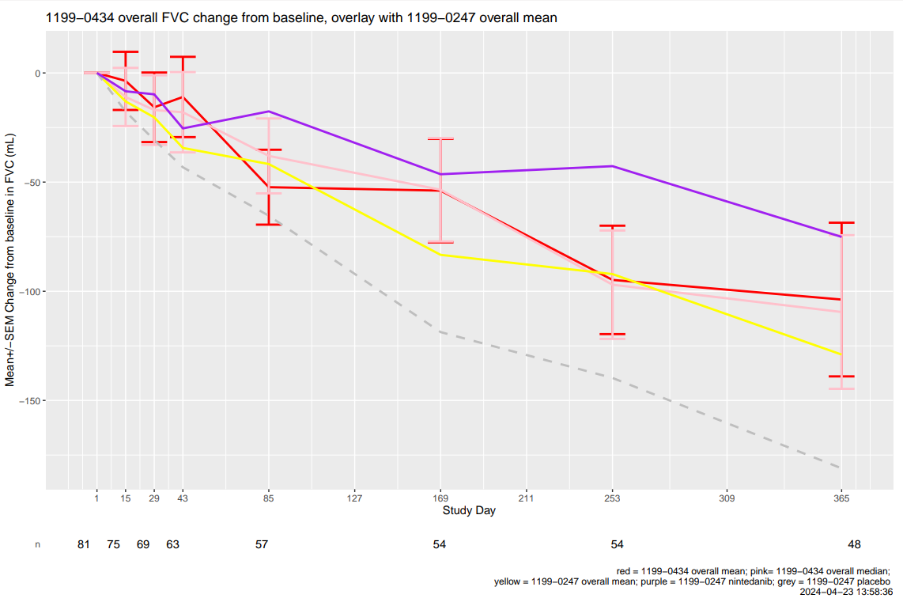
Function update-Statistics and Programming
FVC change from baseline trend (with data cut off 18Apr2024)

Slide 26

Ongoing:
BI 1839100 (TRPA-1 antagonist): IPF/ PPF Cough
2023 |  | 2024 |  |  |  | 2025 |  |  |  | 2026 |  |  |  | 2027 |  |  |  | 2028 |  |  |  | 2029
Q3 | Q4 | Q1 | Q2 | Q3 | Q4 | Q1 | Q2 | Q3 | Q4 | Q1 | Q2 | Q3 | Q4 | Q1 | Q2 | Q3 | Q4 | Q1 | Q2 | Q3 | Q4 | Q1 Q2 | Q3 Q4
We are here
May
2023
MRD
Jan
2024
Aug 2024
Mar
Apr
Sep
Ph2-
1490-0004
Ph2 IPF N=230 (IPF 180+50 PPF)
LSR-Key results*
Mar 2025
CTA sub
Feb 2024
FSS
LSR
PoCP
PoCC
Mar
Jul
Oct
Ph2 PPF cohort
Ph3-
1490-0004
CTA sub
Jan 2026
Apr 2026
Sep 2028
Ph3 in PF-ILD
FSS
US NDA
Jan 2029
US Launch
Feb 2030
Key results
Jul 2023
6 Nov2023
Feb
Aug
Ph2-
1490-0004
Pre-IND 3m for written response
CTA Review + EC + HGRAC + 1st SIV (6m) *
N = 14
Recruit. Window ~7m
LSR-Key results
1st SIV
LSR
Jul 2023
Nov 2023
Ph2 PPF cohort 4m
Jan 2026
Jul 2026
Sep 2028
JP PK study
CTA Review + EC + HGRAC + 1st SIV (6m)
Ph3 in PF-ILD
FSS
JP PK data
1st SIV
Key results
CN NDA
Feb 2029
CN approval
2030
FSS: First subject Screen
LSC: Last Subject complete
LSR: Last subject randomization
SQV: Site qualification visit
AEP: Asset evidence plan
HAI: Health authority interaction
CTA approval expected in May. 1st EC approval from leading site: Mar 20. 1st SIV planned in Aug
IMP will be ready in depot on Aug 19. Short shelf life (expire on Nov 2nd) of 1st batch might potentially impact FSS in China for 1m.

Slide 27
14 Sites are selected
类别 | 研究中心名称 | 主要研究者
组长单位 | 四川大学华西医院 | 罗凤鸣
参与单位 | 首都医科大学附属北京朝阳医院(北京朝阳医院 ) | 崔瑷
参与单位 | 天津医科大学总医院 | 曹洁
参与单位 | 中南大学湘雅二医院 | 彭红
参与单位 | 上海肺科医院 | 徐金富
参与单位 | 上海胸科医院 | 李锋
参与单位 | 安徽省立医院 | 徐晓玲
参与单位 | 徐州医科大学附属医院 | 陈碧
参与单位 | 杭州市第一人民医院 | 王利民
参与单位 | 四川省人民医院 | 郭璐
参与单位 | 广州医科大学附属第一医院 | 韩茜
参与单位 | 南京鼓楼医院 | 代静泓
参与单位 | 浙江大学附属邵逸夫医院 | 吴晓虹
参与单位 | 沈阳市胸科医院 | 王笑歌

Slide 28
Ongoing:
BI 1819479 (AutoTaxin inhi): IPF/ PPF
2023 |  | 2024 |  |  |  | 2025 |  |  |  | 2026 |  |  |  | 2027 |  |  |  | 2028 |  |  |  | 2029
Q3 | Q4 | Q1 | Q2 | Q3 | Q4 | Q1 | Q2 | Q3 | Q4 | Q1 | Q2 | Q3 | Q4 | Q1 | Q2 | Q3 | Q4 | Q1 | Q2 | Q3 | Q4 | Q1 Q2 | Q3 Q4
We are here
Jul 2024
Oct 2025
Jun 2026
Ph2-
1462-0004
CTA sub
Mar 2024
Ph2 IPF (N=300)
PoCP/PoCC in IPF
Aug 2026
FSS
LSR
LSC
Ph3
Mar 2027
Sep 2029
RoFD
Jan 2027
Ph3 in IPF
FSS
LSC
US app
Feb 2031
Ph3 in PPF
FSS
LSC
US NDA
Feb 2030
Mar 2024
Sep 2024
Oct 2025
Jun 2026
Ph2-
1462-0004
CTA Review + EC + HGRAC + 1st SIV (6m) *
Recruitment window
~12m (Site: 15 N=18)
Ph3 in IPF
1st SIV
LSR
LSC
Ph3 in PPF
Ph3
CN NDA
2030
CN app
2031
FSS: First subject Screen
LSC: Last Subject complete
LSR: Last subject randomization
CTA submitted on Mar 28 as planned, accepted on 11 Apr, target approval before 8 Jul 2024.
1st SIV planned in Sep.

Slide 29
Under Evaluation:
BI 765432 IL-11 in IPF/PPF
2023 |  | 2024 |  |  |  | 2025 |  |  |  | 2026 |  |  |  | 2027 |  |  |  | 2028 |  |  |  | 2029 |  |  |  | 2030 |  |  |  | 2031
Q3 | Q4 | Q1 | Q2 | Q3 | Q4 | Q1 | Q2 | Q3 | Q4 | Q1 | Q2 | Q3 | Q4 | Q1 | Q2 | Q3 | Q4 | Q1 | Q2 | Q3 | Q4 | Q1 | Q2 | Q3 | Q4 | Q1 | Q2 | Q3 | Q4 | Q1 | Q2 | Q3 | Q4
We are here
Ph1 SRD
Ph1 MRD
Ph1 JP PK
TBD
Jun 2025
Oct 2027
Ph2
1493-0001
Ph2a/Ph2b
Q1 2028
Q4 2029
Ph3
PoCP
Ph3
US NDA
Apr 2030
US approval
Apr 2031
Ph2
1493-0001
Ph2a/Ph2b
Ph3 TBD
China approval
Q4 2030
  HAI on PK strategy for joining global phase II study (1493-0002) submitted to CDE on 8 Feb 2024: vague feedback from CDE clinical dept. Final feedback back can be expected by mid of May.
HAI: Health authority interaction
Notes:
SRD follow up period is ongoing. Asset team is planning to conduct HAI in focus regions to ask whether we could use the rodent species alon for chronic toxicology studies. The feedback expected by mid feb next year, to facilitate the future planning for toxicology studies. Submisison in China is planend on Nov 22.
To seek considerations from health authoroities.

Slide 30
Under evaluation:
BI1291583(Catc inhibitor): nCF Bronchiectasis
 |  | 2023 |  |  |  | 2024 |  |  |  | 2025 |  |  |  | 2026 |  |  |  | 2027 |  |  |  | 2028 |  |  |  | 2029 |  | 2030
Q3 | Q4 | Q1 | Q2 | Q3 | Q4 | Q1 | Q2 | Q3 | Q4 | Q1 | Q2 | Q3 | Q4 | Q1 | Q2 | Q3 | Q4 | Q1 | Q2 | Q3 | Q4 | Q1 | Q2 | Q3 | Q4 | H1 | H2 | H1 | H2
Ph2-
1397-0012
Jan 2023
Sep 2023
We are here
Jun 2024
Dec 2024
Aug 2022
Airleaf Ph II 1397-0012
PoCC
RoFD
Positive feedback from FDA on our proposal to include CF and non-CF Bronchiectasis patients in one phase III confirmatory study, Global will have further discussion on ‘One-BE’ strategy.
PoCP
LSS
Ph2
1397-0013
Nov 2023
Q4 2024
Clairafly 1397-0013 CF Profiling study
Ph3
1397-0014
Jan 2025
Apr
1397-0014 PhIII
Feb 2028
LSC
CTA
US NDA
Jul 2028
US approval
Mar 2029
Sep 2024
Jan 2025
Jul
CTA Review + EC + HGRAC + 1st SIV (6m) *
PhIII
EoP2 meeting request submission
1st SIV
Jan 2025
Dec
Protocol develop
CTA Review + EC + HGRAC + 1st SIV (6m) *
China PK
PK results
May 2026
China approval
2030 (TBC)
LSC
China team input to AEP, TDO and IAP ongoing. China site pre-feasibility ongoing to collect site comments on draft TDO.
China nominees for global site advisory board
  Yu Li, Shengjing hospital of China Medical University, has been confirmed and under contracting.
China local patient AB meeting was successfully held on 19th Apr 2024, as the 1st local patient AB meeting for clinical trial in China.
AB: Advisory board
TDO: Trial Design Outline
AEP: Asset evidence plan
IAP: Integrated Asset Plan
BTD: Breakthrough designation
PIP: Pediatric investigation plan, EoP2: End of Phase 2
*Based on “model based digital” PoCP
Notes:
ANCA-AV: Anti-Neutrophil Cytoplasmic Antibody-Associated Vasculitis 抗中性粒细胞胞浆抗体相关性血管炎
HS: Hidradenitis Suppurativa
MASH:Metabolic deficiency Associated SteatoHepatitis 代谢缺乏相关脂肪性肝炎
CRS:Chronic RhinoSinositis 慢性鼻窦炎
NE: Neutrophil elastase中性粒细胞弹性蛋白酶

Slide 31

Ongoing:
Avenciguat (sGC Activator): Systemic Sclerosis (SSc)
2022 |  |  |  | 2023 |  |  |  | 2024 |  |  |  | 2025 |  |  |  | 2026 |  | 2027 |  | 2028 | 2029
Q1 | Q2 | Q3 | Q4 | Q1 | Q2 | Q3 | Q4 | Q1 | Q2 | Q3 | Q4 | Q1 | Q2 | Q3 | Q4 | H1 | H2 | H1 | H2
Global
We are here
Ph2
1366-0031
Dec 2022
Oct 2024
Apr 2025
Feb 2026
Ph2 N=200
LSS-key results
Decision: go/no go
early launch
FSS
LSS
IA 160 patient 24W
Nov 2025
Feb 2028
Ph2 OLE
1366-0032
Ph2 OLE FSS-Key results
Ph3
1366-0033
2026 Sep
Ph3
2029 Sep
225 patients screened, 92 randomized globally as of 24Apr2024.
NDA sub
Jan 2030
Launch
Feb 2031
China
Ph2
1366-0031
Jun 2022
Dec 2022
China Ph2b CTA sub.-1st SIV (6M)
Ph2 1366.31 recruit. wind. ~22m
CN ML: 18 sites/25 patients; TW: 2 patients
LSS-Key results
CTA
1st SIV
Ph3
1366-0033
Recruitment Window: TBD
31 patients screened, 10 (+1) randomized in China. Global TOP 1 for recruitment.
HGRAC approval for CTP v4.0 on 19Apr2024.
China NDA sub
Feb 2030
sGC: soluble guanylate cyclase
LSS: Last subject screening
LSC: Last subject complete
SQV : site qualification visit
FSS: First subject screening
CN ML: China mainland
China NDA App
May 2031
Notes:
In case the results for the phase 2 study show compelling medical meaningfulness and statistical significance, early submission based on a single phase 2 study will be considered.
Lupus,

Slide 32
Global enrollment (COD=23-Apr-2024)
Global | Dec-22 | Jan-23 | Feb-23 | Mar-23 | Apr-23 | May-23 | Jun-23 | Jul-23 | Aug-23 | Sep-23 | Oct-23 | Nov-23 | Dec-23 | Jan-24 | Feb-24 | Mar-24 | Apr-24 | May-24 | Jun-24 | Jul-24 | Aug-24 | Sep-24 | Oct-24 | Nov-24
Screening-p | 2 | 7 | 12 | 26 | 31 | 38 | 51 | 66 | 82 | 101 | 124 | 148 | 172 | 196 | 220 | 244 | 268 | 292 | 316 | 340 | 364 | 388 | 400 | 400
Screening-a | 2 | 7 | 12 | 26 | 31 | 38 | 52 | 68 | 86 | 102 | 115 | 144 | 151 | 180 | 193 | 203 | 225
Enrollment-p | 0 | 2 | 6 | 9 | 11 | 13 | 14 | 17 | 21 | 27 | 36 | 48 | 60 | 72 | 84 | 96 | 108 | 120 | 132 | 144 | 158 | 172 | 186 | 200
Enrollment-a | 0 | 2 | 6 | 9 | 11 | 13 | 14 | 19 | 29 | 34 | 41 | 57 | 57 | 71 | 73 | 83 | 92

Slide 33
China Mainland enrollment (COD=23-Apr-2024)
Pre-screening 1214 pts, 1149 pre-screening failure, 34 in follow up, 31 screened.
China Mainland | Dec-22 | Jan-23 | Feb-23 | Mar-23 | Apr-23 | May-23 | Jun-23 | Jul-23 | Aug-23 | Sep-23 | Oct-23 | Nov-23 | Dec-23 | Jan-24 | Feb-24 | Mar-24 | Apr-24 | May-24 | Jun-24 | Jul-24 | Aug-24 | Sep-24 | Oct-24 | Nov-24
Screening-p | 0 | 0 | 1 | 3 | 5 | 8 | 10 | 13 | 14 | 15 | 17 | 19 | 23 | 25 | 26 | 29 | 32 | 35 | 38 | 41 | 44 | 47 | 50 | 50
Screening-a | 0 | 0 | 0 | 5 | 6 | 10 | 10 | 13 | 15 | 16 | 18 | 19 | 23 | 23 | 24 | 25 | 31
Enrollment-p | 0 | 0 | 0 | 0 | 1 | 0 | 0 | 2 | 3 | 4 | 5 | 6 | 7 | 9 | 11 | 13 | 15 | 17 | 19 | 20 | 21 | 22 | 24 | 25
Enrollment-a | 0 | 0 | 0 | 0 | 1 | 1 | 1 | 2 | 3 | 4 | 5 | 7 | 7 | 9 | 9 | 9 | 10

Slide 34
Mitigation Plan for patient recruitment in China
  Interim Investigator meeting (online) on 09May2024
  Patient engagement materials developed to distribute to investigators and SSc pts.
  Cross-functional boosting visits to non-performing sites (CDMA)
  Catchup weekly with recruitment vendor to identify more potential patients from patient organization.
  KL-6 assay ready in China for patient selection by Apr 2024, if timely delivery of kit reagents needed to assay validation to Teddy Labs in China.
  Public patient education short videos on multiple platforms, including patient communities

Slide 35
Under Evaluation:
BI 765250 PD-1 agonist in SSc
2023 |  | 2024 |  | 2025 |  | 2026 |  | 2027 |  | 2028 |  | 2029 |  | 2030 |  | 2031 |  | 2032 |  | 2033
Q1 Q2 | Q3 Q4 | Q1 Q2 | Q3 Q4 | Q1 Q2 | Q3 Q4 | Q1 Q2 | Q3 Q4 | Q1 Q2 | Q3 Q4 | Q1 Q2 | Q3 Q4 | Q1 Q2 | Q3 Q4 | Q1 Q2 | Q3 Q4 | Q1 Q2 | Q3 Q4 | Q1 Q2 | Q3 Q4 | Q1 Q2 | Q3 Q4
We are here
Ph1 SRD HV
SRD
  PD-1 agonist elevated to TA priority asset.
  Scenarios for overall development plan and Ph2 dose finding strategy under evaluation. Will discuss with HPSC end of Apr.
  Asset team preliminary plan is to include China to ph2.
Ph1 MRD in Pso
1474.2
MRD
SSc
PoCP
Nov 2024
JP Ph1
Placeholder
JP Ph1
Ph2in SSc
Ph2 in SSc
Ph3 in SSc
Ph3 in SSc
2032 Jul
US Submission
US launch
Aug2033
Development plan
To be updated
Ph2in SSc
Ph2 in SSc
Ph3 in SSc
Ph3 TBD
HAI: Health authority interaction
Notes:
Peking Union Medical College Hospital, Shenzhen Children‘s Hospital, People's Liberation Army General Hospital (301 Hospital)
As mentioned, cGAS asset team has initiated the evaluation of China and Jp integration to inteferferonopathy program. China team had a cross functional evaluation. Based on literature research, we have identified at least 25 cases from 3 hospitals in China. Therefore we proposed to join global pivotal program starting from 2026, and non-IMP study and chart review study to be initiated next year，with the purpose is to gain knowledge on the natural course of the disease to inform trials and support future regulatory needs, and identification of patients for later interventional study.
Team will discuss with asset team end of Nov about the China integration proposal
Pediatric and adult patients with select type 1 monogenic interferonopathies, including and limited
to AGS, SAVI, FCL and COPA, with confirmed genetic mutation in the cGAS/STING pathway (

Slide 36
PD-1 agonist：Integrated Development Plan
Enables potential SSc launch in 2031 (fastest possible entry to market) + PMR launch in 2033
Scenario 1:
D-F Phase 2 in PMR followed by Phase 3’s in PMR & GCA.
Registrational intent Phase 2 in SSc with potential for early BLA
PhIII in GCA (1 or 2 active dose)
TBD
MRD/PoCP in Psoriasis
PhII in PMR (3 active doses)
PhIII in PMR (1 active dose)
Q3/2033
PhII in SSc (2 active doses)
PhIII in SSc (1-2 active doses)
Q3/2033 to Q2/2034
Q1/2031
with 1 or 2 active dose groups
Registrational intent PhII study
EoP2/pre-BLA interaction (depends on PhII results & HA feedback)
Gain confidence in Phase II PMR D-F before investing in other indications
Scenario 2:
D-F Phase 2 in PMR followed by Phase 3’s in PMR & GCA.
SSc development starts after positive PMR D-F results
PhIII in GCA (1 or 2 active dose)
TBD
MRD/PoCP in Psoriasis
PhII in PMR (3 active doses)
PhIII in PMR (1 active dose)
Q3/2033
PhII or III in SSc (1-2 active doses)
PhIII in SSc (1-2 active doses)
Q1/2035
Q2/2037 to Q2/2038
with 1 or 2 active dose groups
SSc timelines are based on recruitment rates projected for currently ongoing studies (sGCa VitaliSSce, anifrolumab DAISY) whereas PMR timelines are based on recruitment rates achieved in a completed study (sarilumab PhIII Saphyr)
Polymyalgia rheumatica (PMR) & Giant cell arteritis (GCA)
风湿性多肌痛&巨细胞动脉炎
Notes:
1)

Slide 37
Under Evaluation:
BI3000202 (cGAS inh.) in Interferonopathy (干扰素病)
2023 |  | 2024 |  | 2025 |  | 2026 |  | 2027 |  | 2028 |  | 2029 |  | 2030 |  | 2031 |  | 2032 |  | 2033
Q1 Q2 | Q3 Q4 | Q1 Q2 | Q3 Q4 | Q1 Q2 | Q3 Q4 | Q1 Q2 | Q3 Q4 | Q1 Q2 | Q3 Q4 | Q1 Q2 | Q3 Q4 | Q1 Q2 | Q3 Q4 | Q1 Q2 | Q3 Q4 | Q1 Q2 | Q3 Q4 | Q1 Q2 | Q3 Q4 | Q1 Q2 | Q3 Q4
We are here
Ph1 SRD HV
SRD
Ph1 MRD HV
1509.2
MRD
Jan 2025
Mar 2028
SSc
Ph1c MTD
1509-0003
INFopathy
PoCP
Mar 2026
JP Ph1
Placeholder
JP Ph1
Jul 2026
Dec 2028
Ph2in SSc
Ph2 in SSc
Jan 2029
Jan 2032
2033 Jun
Ph3 in SSc
Ph3 in SSc
US Lunch
Jan 2027
Jun 2030
JuL 2031
Ph2/3 in INFopathy
1509-0018
Ph2/3 adult Neonates (staggered) N=~54
US launch
Non IMP
1509-0019
Non-IMP low interventional study
Interferonopathy
Chart review
chart review
Chinese adult patient information (e.g. number and mutation) under collection, for feasibility evaluation of China joining global ph1c study. Will provide to asset team early May.
Notes:
Peking Union Medical College Hospital, Shenzhen Children‘s Hospital, People's Liberation Army General Hospital (301 Hospital)
As mentioned, cGAS asset team has initiated the evaluation of China and Jp integration to inteferferonopathy program. China team had a cross functional evaluation. Based on literature research, we have identified at least 25 cases from 3 hospitals in China. Therefore we proposed to join global pivotal program starting from 2026, and non-IMP study and chart review study to be initiated next year，with the purpose is to gain knowledge on the natural course of the disease to inform trials and support future regulatory needs, and identification of patients for later interventional study.
Team will discuss with asset team end of Nov about the China integration proposal
Pediatric and adult patients with select type 1 monogenic interferonopathies, including and limited
to AGS, SAVI, FCL and COPA, with confirmed genetic mutation in the cGAS/STING pathway (

Slide 38

Ongoing:
BI 706321 (RIPK2 inhibitor): Crohn’s Disease (CD)
2021 |  | 2022 |  | 2023 |  | 2024 |  | 2025 |  | 2026 |  | 2027 |  | 2028 |  | 2029 |  | 2030 |  | 2031
Q1 Q2 | Q3 Q4 | Q1 Q2 | Q3 Q4 | Q1 Q2 | Q3 Q4 | Q1 Q2 | Q3 Q4 | Q1 Q2 | Q3 Q4 | Q1 Q2 | Q3 Q4 | Q1 Q2 | Q3 Q4 | Q1 Q2 | Q3 Q4 | Q1 Q2 | Q3 Q4 | Q1 Q2 | Q3 Q4 | Q1 Q2 | Q3 Q4
We are here
Oct 2021
N=50
2024 Dec
Ph2a-
1425.3
FPI
Primary endpoint LPO
Jun 2024
LPO
Aug 2025
Sep 2028
Ph2b-
1425.4
N=210
PoCP
Aug 2024
FPI
Jun 2028
LPO
Sep 2031
Ph3-
1425.5
CTA sub
Sep 2024
May 2025
TNF failure (N=700)
Ph3-
1425.6
FPI
LPO
Jun 2028
Mar 2032
Feb 2022
Aug 2022
Chinese HV PK data available
TNF naïve & non-failure (N=700)
JP Ph1-
1425.8
Pan Asia PK
Chinese
part
FPI
LPO
FPI
LPO
Dec 2025
NDA APP
Jul 2033
CDE accepts JP
PK data (Low POS)
May 2025
Nov 2025
Sep 2027
Sep 2028
Ph2b-
1425.4
1
CTA Review + EC + HGRAC + 1st SIV (6m)
China Ph2 1425.4 recruitment wind. ~20m
LSS-LSC
Aug
2021
Dec
2021
Dec 2025
LPR
LPO
Pre-IND
2
Hold Chinese cohort
after Ph2b CTA feedback
(Agreed by asset team)
CTA
sub
-app
.
Ph2 sites set up#
China Ph2 1425.4 recruitment wind. 17~20m
LSS-LSC
MR Sub
WR
CDE
feedback
LPR
LPO
Ph3-
1425.5
TNF naïve & non-failure
Ph3-
1425.6
CTA submission for Ph2b moved from Sep 2024 to May 2025, to reduce early frontloading activities until the key results of the PoCP trial becomes available. (Jul-Aug 2024)
TNF naïve & non-failure
(# additional 1-3m might be needed for another round of EC review on PK data)
CN NDA App
2034

Slide 39
Under Evaluation:
BI 3032950 (Anti-TREM1): Crohn’s Disease (CD)
2022 |  | 2023 |  | 2024 |  | 2025 |  | 2026 |  | 2027 |  | 2028 |  | 2029 |  | 2030 |  | 2031 |  | 2032
Q1 Q2 | Q3 Q4 | Q1 Q2 | Q3 Q4 | Q1 Q2 | Q3 Q4 | Q1 Q2 | Q3 Q4 | Q1 Q2 | Q3 Q4 | Q1 Q2 | Q3 Q4 | Q1 Q2 | Q3 Q4 | Q1 Q2 | Q3 Q4 | Q1 Q2 | Q3 Q4 | Q1 Q2 | Q3 Q4 | Q1 Q2 | Q3 Q4
We are here
Oct 2022
Sep 2023
Ph1 SRD-
1486.1
SRD
May 2023
Jan 2024
Ph1 MRD-
1486.2
MRD
Q4 2024
PK data (TBD)
JP Ph1
1486.4
JP Ph1/Pan Asia
JP cohort FPI
CN cohort
FPI
CN cohort
LPO
Dec 2024
Aug 2028
Ph2a in UC
Ph2a in UC-
1486.5
PoCP
Jul 2026
Oct 2026
Nov 2029
Ph2b
Ph2b
Jul 2029
Jul 2032
Ph3
Ph3
2033 Aug
US Lunch
Nov 2029
Ph2b
China Ph2b CTA sub.-1st SIV (6M)
China Ph2b recruitment TBD
Ph3
Therapeutic Area Management cost saving efforts for 2024 and 2025: Pan –Asian Ph1 study postponed to 2026.
Scenarios evaluation to allow Japan/China join global PhIIb to be discussed on Apr 25. China team proposal: to initiate Pan Asian PK or dedicated China PK study from the beginning of 2026
Ph3
2033 TBD
CN NDA App

Slide 40
China joining TREM-1 Ph2b timeline
2025 |  |  |  | 2025 |  |  |  | 2026 |  |  |  |  |  |  |  |  |  |  |  | 2027 |  |  |  |  |  |  |  |  |  |  |  | 2028
5 | 6 | 7 | 8 | 9 | 10 | 11 | 12 | 1 | 2 | 3 | 4 | 5 | 6 | 7 | 8 | 9 | 10 | 11 | 12 | 1 | 2 | 3 | 4 | 5 | 6 | 7 | 8 | 9 | 10 | 11 | 12 | 1 | 2 | 3 | 4 | 5 | 6 | 7 | 8 | 9 | 10
CTA submission
Jun 2026
FSS Oct 2026
LSR
Sep 2028
Ph2b recruitment
FSS
Jan 2026
LSC
Jul 2026
Option 1: Pan Asian PK initiation in Jan 2026
Pan Asian PK
Pan Asian PK-Chinese cohort
PK results
Aug 2026
1st SIV
Feb 2027
Chinese cohort initiation
Mar 2026
CTA Review + EC + HGRAC + 1st SIV (6m) *
Ph2b recruitment window in China~ 17m
Option 2: China PK study if JP PK is not needed based PMDA feedback (protocol development and CTA frontloaded)
FSS
Jan 2026
LSC
Jun 2025
PK result
Oct 2026
CTA
Jun 2025
1st SIV
Dec 2025
CTA Review + EC + HGRAC + 1st SIV (6m) *
China PK study
PK sample export (2m)+analysis 1m
+1m report
CTA submission
Oct 2026
1st SIV
Mar 2027
China PK Protocol develop
kick off Feb 2025
CTA Review + EC + HGRAC + 1st SIV (6m) *
Ph2b recruitment window in China~ 15m
Option 3: China PK study if JP PK is not needed based PMDA feedback (protocol development and CTA not frontloaded)
Most China sites have only 2m recruitment
Protocol development
CTA Review + EC + HGRAC + 1st SIV (6m) *
China PK study
PK sample export (2m)+analysis 1m+1m report
CTA
Apr 2026
1st SIV
Oct 2025
LSC
Apr 2027
PK result
Aug 2027
1st SIV
Feb 2028
China PK Protocol develop
kick off Jan 2026
FSS
Nov 2026
CTA submission
Aug 2027
CTA Review + EC + HGRAC + 1st SIV (6m) *
Ph2b recruitment window in China~ 5m

Slide 41
China PK Strategy Options
Option 1: Pan Asian PK study initiation from beginning of 2026
  Protocol and CTA needs to be frontloaded
Option 2: China PK study in China, JP PK is not needed based PMDA feedback (with China PK protocol and CTA frontloaded before 2026)
  Study Design: Single dose evaluation with healthy volunteers
    6 active + 2 placebo for each dose groups (total 8 x 3 = 24 subjects)
    i.v. 2 dose (2nd dose evaluation will be started one month later from 1st dose with safety monitoring)
    s.c. 1 dose (parallel with 1st i.v. dose)
    evaluation period for each cohort will be 4 months
Option 3: China PK study in China, JP PK is not needed based PMDA feedback (with China PK protocol kick off in 2026)
  Study Design: same as Option 2

Slide 42
China joining TREM-1 Ph2b timeline (back up option 4)
2025 |  |  |  | 2025 |  |  |  | 2026 |  |  |  |  |  |  |  |  |  |  |  | 2027 |  |  |  |  |  |  |  |  |  |  |  | 2028
5 | 6 | 7 | 8 | 9 | 10 | 11 | 12 | 1 | 2 | 3 | 4 | 5 | 6 | 7 | 8 | 9 | 10 | 11 | 12 | 1 | 2 | 3 | 4 | 5 | 6 | 7 | 8 | 9 | 10 | 11 | 12 | 1 | 2 | 3 | 4 | 5 | 6 | 7 | 8 | 9 | 10
CTA submission
Jun 2025
FSS Oct 2026
LSR
Sep 2028
Ph2b recruitment
FSS
Jan 2026
LSC
Jul 2026
Option 1: Pan Asian PK initiation in Jan 2026
Pan Asian PK
Pan Asian PK-Chinese cohort
PK results
Aug 2026
1st SIV
Feb 2027
Chinese cohort initiation
Mar 2026
CTA Review + EC + HGRAC + 1st SIV (6m) *
Ph2b recruitment window in China~ 17m
Option 2: China PK study if JP PK is not needed based PMDA feedback (protocol development and CTA frontloaded)
FSS
Jan 2026
LSC
Jun 2025
PK result
Sep 2026
CTA
Jun 2025
1st SIV
Dec 2025
CTA Review + EC + HGRAC + 1st SIV (6m) *
China PK study
PK sample export (2m)+analysis 1m
CTA submission
Sep 2026
1st SIV
Mar 2027
China PK Protocol develop
kick off Feb 2025
CTA Review + EC + HGRAC + 1st SIV (6m) *
Ph2b recruitment window in China~ 16m
Option 4: China PK study if JP PK is not needed based PMDA feedback (ONLY protocol development frontloaded)
Protocol development
CTA Review + EC + HGRAC + 1st SIV (6m) *
China PK study
PK sample export (2m)+analysis 1m+report 1m
1st SIV
Jul 2026
PK result
Apr 2027
1st SIV
Nov 2027
China PK Protocol develop
kick off Sep 2025
CTA
Jan 2026
FSS
Aug 2026
LSC
Jan 2027
CTA submission
May 2027
CTA Review + EC + HGRAC + 1st SIV (6m) *
Ph2b recruitment window in China~ 8m

Slide 43
PDE4 PK study budget reference
Total budget 1,393,125 Euro
Before SIV, the payment was 436,580 Euro, around 31% of total budget.

Slide 44
TREM-1 development Schedule and Option for JP
Try to recruit Asian patients
(living in U.S, European countries etc)
①Consultation before Ph2a
Yes
Jun
2027
Feb 2025
No
②Pan-Asian Ph1
(Japanese part)
Yes
Jan
2026
Jun
2026
No
③Consultation
before Ph2b
Aug
2026
Oct
2026
Feb
2027
Yes= acceptable to join gPh2 w/o J-Ph1 data
No=J-Ph1 data to be available before gPh2

Slide 45
China PK Study Needs
PK data on Chinese population is considered pre-requisite to further join global MRCT study, based on industry intelligence.
  We learn from some industry intelligence that evaluation division of IBD in CDE require PK study in Chinese subjects prior to further trials in China. (5 companies got CDE reviewer's request to conduct China PK study ahead of join global Ph2 or Ph3. The requests seem neither related to study phase (ph2 or ph3), nor related to compound modality (small molecule or biologics), nor JP PK data availability.)
If Pan Asian PK study is not planned in JP, to ensure China can join global phase IIb study smoothly with enough recruitment window, a dedicated China PK study is necessary.

Slide 46
Inflammation Product Overview
Substance/ MOA/Formulation | Indication | Study type/Global Status (Study no.: FPI-LPO, CTR) | China Dev. Strat. | Current Status | Next Mile-stone | Key Updates
China IPF Registry Study (PORTRAY) | IPF | IIS (1199-0302) (Jul2018-July2026,July2027) | China alone | Follow up | LPO： July 2026 | Completed recruitment in Apr 2023 Follow up ongoing
IPF SURVEY | IPF | ECR(1199-0562) (Sep2023-Jul2026) | China alone | EC approval | Contract effective(Jul2024) | Protocol approved 20Feb2024 EC approval 11Mar2024 Contract review process
Development and Validation of a Patient Reported Outcomes (PRO) Questionnaire of Patients with Pulmonary Fibrosis in China | IPF | ECR（2024-2025） | China alone | PEC endorsement | Proposal approval(Mar2024) | PEC endorsed this study in Dec 2023 Further revision on the proposal (including PI, timeline, etc.) ongoing.
A Prospective, Multi-Center Registry Study of Progressive Pulmonary Fibrosis (PPF) in China (PROFINA) | PPF | ECR (2023-2027) | China alone | PEC approval | Global endorse(Apr2024) | PEC approval obtained on 28Feb2024 Under hybrid review process

Slide 47
Spesolimab Update

Slide 48
Spevigo sNDA Roadmap – GPP flare prevention
Global
Nov
US Pre-submission Interaction
Feb 10
Global Top-line Results
Feb 27
US BTD Submission
May 18
US sBLA Submission
May 18
US Priority Review Application
Jul 24
FDA noticed standard review
Mar 18
US Approval
Apr 28
US BTD Granted
2022
2023
2024
Feb 13
Chinese Subgroup Top-line Results
Feb 17
Pre-NDA Interaction Request
Feb 24
BTD Submission
Apr 19
BTD Granted
PR Applied
May 11
sNDA Submission
May 25
Accepted by CDE
May 30
Pre-NDA Interaction
Feedback
Jun 29
PR Granted
Mar 05
China Approval
China
Globally first approval in China!
48

Slide 49
Spevigo sNDA for GPP flare prevention in China – Best Case
We are here
May 2023
Jun 2023
Jul 2023
Aug 2023
Sept 2023
Oct 2023
Nov 2023
Dec 2023
Jan 2024
Feb 2024
Mar 2024
NDA Submission
CDE Technical Evaluation (1st round)
May 2023 – Oct 2023
CDE Technical Evaluation (2nd round)
Nov 2023 – Feb 2024
NMPA Review
QC Testing
Jul 2023 – Nov 2023
Panel meeting (Jan 19)
Labeling discussion (TC on Feb 02)
MTP,CNTS finalized
GCP Inspection
Jul 2023 – Nov 2023
NDA Submission
11 May 2023
GCP Inspection Notice
11 Jul 2023
Inspection Report Transferred to CDE
08 Nov 2023
PR Granted
29 Jun 2023
Registration Testing
Start
20 Jul 2023
Deficiency Letter
27 Oct 2023
Registration Testing Finish
07 Nov 2023
Supplementary Submission
24 Nov 2023
Approval
05 Mar 2024
10 Months
Approved indication 本品适用于减少12岁及以上青少年（体重≥40 kg）和成人的泛发性脓疱型银屑病（GPP）发作。

Slide 50
Status in Other Regions
EMA D 120 LoQ response submitted 18 Jan, D 150 AR received on 27 Feb, Day 180 LoQ by mid Mar.
FDA action and approval of the Spevigo sBLA on Mar 18. The approved FDA indication from the US PI is “SPEVIGO is an interleukin-36 receptor antagonist indicated for the treatment of generalized pustular psoriasis (GPP) in adults and pediatric patients 12 years of age and older and weighing at least 40 kg”.
JP submission plans under discussion
Taiwan DL response due date Feb 26, approval is planned in JUL 2024
HK planned to submit on 1/15/2025 (best) or 4/15/2025 (base) , approval on 10/15/2025 or 4/15/2026

Slide 51
Ongoing:
BI 655130 (Anti-IL36R): General Pustular Psoriasis (GPP)
2020 |  | 2021 |  | 2022 |  | 2023 |  | 2023 |  | 2024 |  | 2024 |  | 2025 |  | 2023 |  | 2026 |  | 2024 |  | 2027
Q1 Q2 | Q3 Q4 | Q1 Q2 | Q3 Q4 | Q1 Q2 | Q3 Q4 | Q1 | Q2 | Q3 | Q4 | Q1 | Q2 | Q3 | Q4 | Q1 | Q2 | Q3 | Q4 | Q1 | Q2 | Q3 | Q4 | Q1 Q2 | Q3 Q4
NDA App (US)
for GPP Flare Sep 2022
We are here
Ph3b/4-1368.120
Oct 2023
Dec 2024
Apr 2027
14m recruitment (N=40)
FSS
LSS
LSC
May 2019
Feb 2023
1368.25 (OLE)
A CTP amendment under discussion: update the treatment duration to be such as ‘up to 5 years or until s.c. spesolimab is available in the market, whichever is shorter’
Jan 2028
Ph3 OLE-1368.25
N=130
FSS
LSS
LSC
Ph2b-1368.27
Jun 2020
Dec 2021
Nov 2022
18May 2023 (US)
18Mar 2024
1368.120 (PAC)
44 patients screened, 25 randomized, 15 in screeing as of 16Apr.
Global recruitment is speeding up. only to screen patient who are flaring.
Flare Prevention (N=123)
NDA Review
FSS
LSR
LSC
NDA Sub
NDA App
NDA App for GPP Flare
CN ML: 13Dec2022
TW: 6Jan2023
Jun 2023
16Oct2023
Dec 2024
Apr 2027
Ph4-1368.120
EC + HGRAC + 1st SIV
~14m recruitment window
China Mainland: N=5 TW: N=2
1st SIV
LSS
LSC
Ph2 OLE-1368.25
Sep 2020
Oct 2022
Dec 2027
N=14
1st SIV
LSS
LSC
Ph2b-1368.27 (Effisayil 2)
1368.120 (PAC)
7 patients screened, 4 randomized, 1 in screening. 1 early discontinued.
TW: 7 patients screened, 4 randomized.
IMP ordered for extra patients, arrived local depot on Apr15.
Jan 2020
Oct 2020
Aug 2021
Sep
Dec 2022
11 May 2023
5Mar 2024
CTA Review + EC + HGRAC + 1st SIV
China ML N=18, TW N=4
NDA Review
CTA Sub
1st SIV
LSR
LPO (CN)
LPO (G)
NDA Sub
NDA App
FSS: First subject screening
LSS: Last subject screening
LSC: Last subject complete
LSR: Last subject randomization
CN ML: China mainland
TW: Taiwan
SF: Screen failure
Notes:
1368-0025: concern that CDE required to complete the ongoing trial 1368-0025 and submit clinical trial report in the approval letter of initial NDA. If the trial duration is shortened (since sc would be available in China market soon) , it seems the trials is ‘not’ completed in this way and long term safety data cannot be collected as planned.
1368-0120:
15+ in screening waiting for flare.
HGRAC approval on 15 patients recruitment on 28Dec2023.

Slide 52
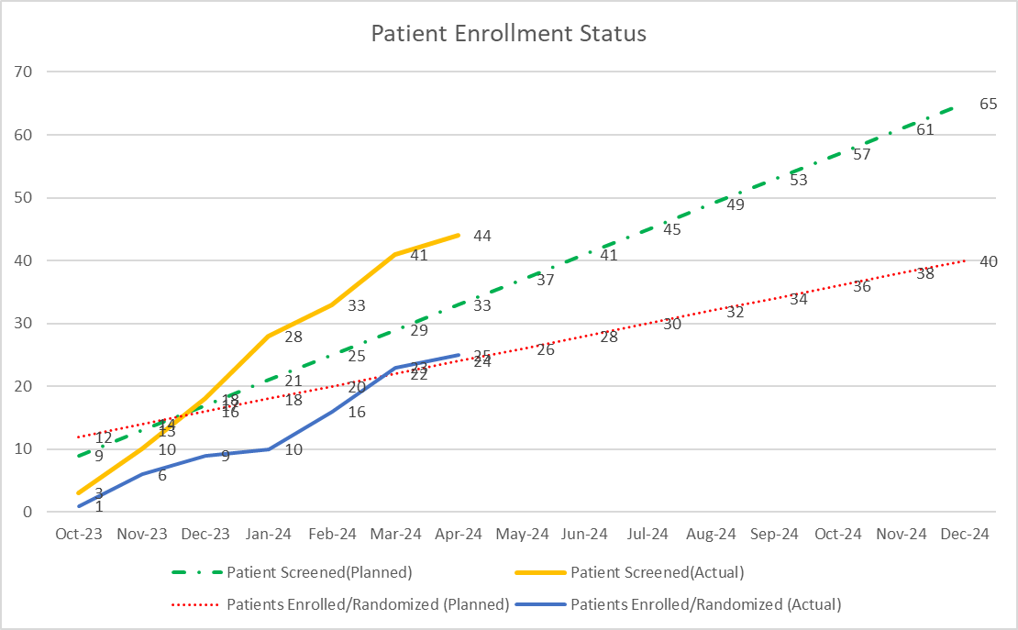
1368-0120-Global Recruitment Curve (as of 16Apr2024)
Total Screened = 44
Total Randomized = 25
Total in Screening = 15
Total Screen failure = 3
Treatment complete=4
Screen failure rate = 6%
Early discontinuation study =0

Slide 53
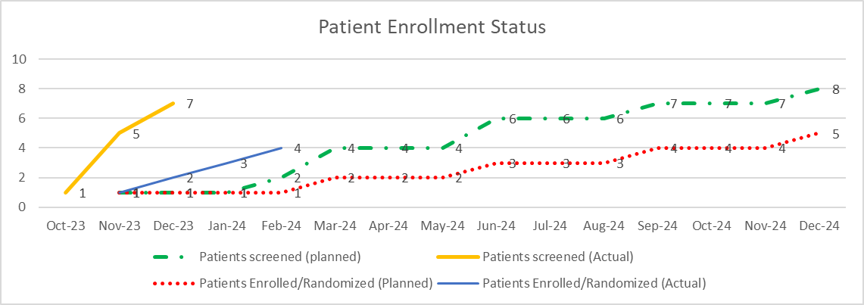
1368-0120-China Reruitment Curve (as of 15Apr2024)-No update
Total Screened = 7
Total Randomized = 4
Total in Screening = 1
Total Screen failure = 2
Screen failure rate = 28%
Early discontinuation treatment =1
Early discontinuation study= 0
China recrutiment source data
Months | Oct-23 | Nov-23 | Dec-23 | Jan-24 | Feb-24 | Mar-24 | Apr-24 | May-24 | Jun-24 | Jul-24 | Aug-24 | Sep-24 | Oct-24 | Nov-24 | Dec-24
Patients screened (planned) |  | 1 | 1 | 1 | 2 | 4 | 4 | 4 | 6 | 6 | 6 | 7 | 7 | 7 | 8
Patients screened (Actual) | 1 | 5 | 7 | 7 | 7 | 7 | 7
Patients Enrolled/Randomized (Planned) |  | 1 | 1 | 1 | 1 | 2 | 2 | 2 | 3 | 3 | 3 | 4 | 4 | 4 | 5
Patients Enrolled/Randomized (Actual) |  | 1 | 2 | 3 | 4 | 4 | 4
Screening Failure Rate |  |  | 14%

Slide 54
Ongoing:
BI 655130 (Anti-IL36R): Hidradenitis suppurativa (HS)
 |  | 2022 |  |  |  | 2023 |  |  |  | 2024 |  |  |  | 2025 |  |  |  | 2026 |  |  |  | 2027 |  |  |  | 2028 |  |  |  | 2029
 |  | Q1 | Q2 | Q3 | Q4 | Q1 | Q2 | Q3 | Q4 | Q1 | Q2 | Q3 | Q4 | Q1 | Q2 | Q3 | Q4 | Q1 | Q2 | Q3 | Q4 | Q1 | Q2 | Q3 | Q4 | Q1 | Q2 | Q3 | Q4 | Q1 | Q2 | Q3 | Q4
We are here
248 patients screened, 164 patients randomized as of 24Apr.​
Ph2 recruitment timeline and key milestones updated with 3-month acceleration
EoP2 HAI planned in Jan. 2025. Detailed timeline and core BB including question list are under discussion
Sep 2024
Week 8 analysis
FPI
Ph2b/3 Lunsayil-1 -
1368.98
Apr 2023
Jun 2024
Sep 2025
Ph IIb part FSS-LSR
(N=200)
LSR-LSC
Interim analysis
Dec 2027
DMC review
Nov
Oct 2025
Apr 2027
Aug 2028
IA @ week 16
Nov 2024
Ph III part (FSS-LSR)
~17m for recruitment
LSR-LSC
Ph3-
1368.0100
EoP2 Meeting US
Jan 2025
Ph III part (FSS-LSR)
~17m for recruitment
LSR-LSC
Apr 2024
CTA
Jul 2025
Jul 2029
Ph2b/3 OLE-
1368.0130
Ph2b/3 OLE FSS-key results
BLA submission
Apr 2028
sNDA approval
Apr 2029
Ph2b/3 Lunsayil-1 -
1368.98
Feb2023
Aug2023
21Dec 2023
CTA Review + EC + HGRAC (6m)
Ph IIb (N=8)
LSR-LSC
Sep 2025
Mar 2026
CTA
1st SIV
ready
1st SIV
EoP2 Meeting Jan 2025
CTA Amend+ EC + HGRAC (6m)
Ph III part (FSS-LSR)
~13m for recruitment
LSR-LSC
Ph2b/3 OLE-
1368.0130
TBD
Jul 2029
CTA
Dec 2024
Ph2b/3 OLE FSS-key results
RoFD: Release of full development
HAI: Health authority interaction
FSS: First subject screening
LSS: Last subject screening
LSC: Last subject complete
LSR: Last subject randomization
EoP2: End of Phase 2
17 patients screened. 10 patients randomized (originally committed 8 patients, achieved 5 months ahead of the recruitment plan), 3 patients under screening​
China interim investigator meeting (experience/case sharing) successfully held on 22nd Apr 2024.
EoP2 HAI planned in Jan. 2025.
CN sNDA sub
Apr 2028
CN sNDA approval
Jul 2029
Notes:
Milestone achieved 5 months ahead of the recruitment plan
Leading PI suggested to plan case sharing meeting with other sites to make sure all the efficacy assessment are consistent. The meeting scheduled on 22Apr2024 at 19:00
The drug stock is available for 12 cases. The third batch is expected to be in place in April.
SIV status: 8 sites initiated. 1 site plans to initiate on 18Mar2024. 1 site pending contract negotiate.
New shipment completed inbound on 26Feb2024.
HGARC: CTP 2.0 has fully completed filling on 29Feb2024.
End of Phase II HAI will be moved to Jan 2025 with BB ready in Dec 2024. Core BB drafting was kicked off in Feb and prosed question list is under discussion, China team can input anytime from now on.
H2H study in planning, planned early next year, to be updated.
The commitment was stated in a cover letter that treatment in the trial may only be started in China after at least one patient has received 1800mg dose for 4 weeks in the study and no serious safety observation is raised for ph2b part of 1368-0098
● OLE (1368-0130) for HS, as long as participate in 1368-0098, then will roll over to 1368-0130
➢ The final TDO will be ready on 28 Aug, there is ongoing discussion that will be self-administered treatment at home;
➢ Final protocol planned on 23 Oct; final CTA package planned on 27 Nov 23 with IMPD V4.0 (vs V3.0 for 1368-0098);
➢ CTA is needed in China, target submission in Dec, approval in Mar 2024;
➢ First site initiated 12-Apr 24.

Slide 55
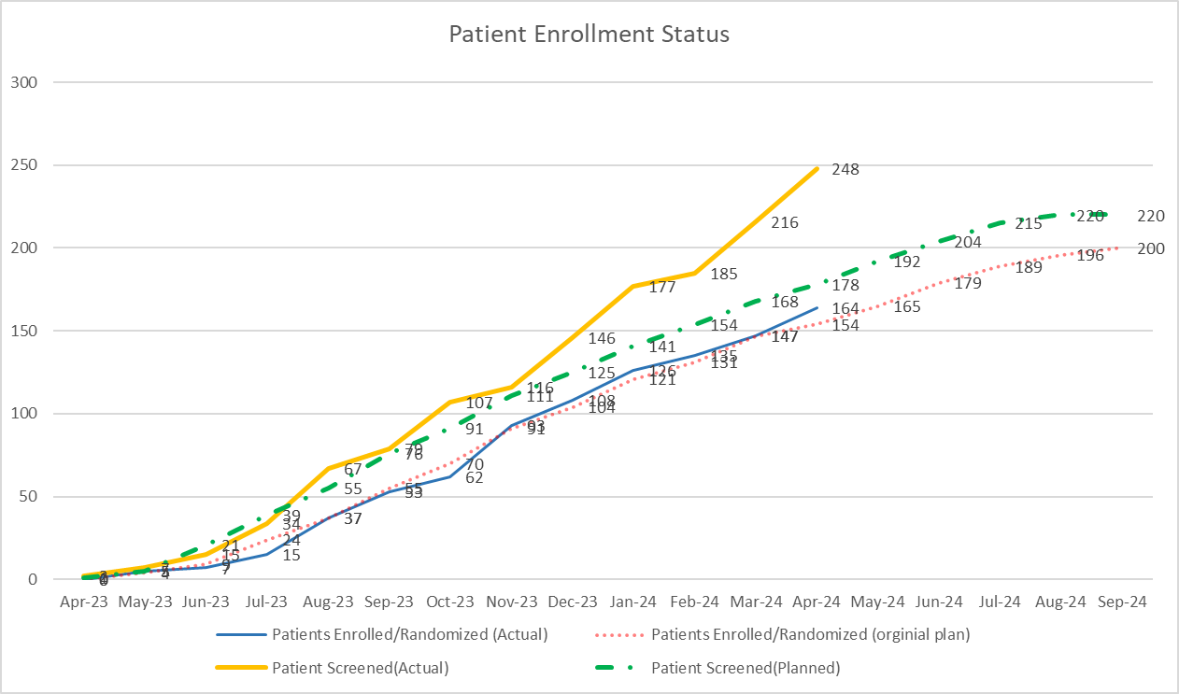
1368-0098 HS Global recruitment information- 24Apr2024
Total Screened = 248
Total Randomized = 164
Total Screen failure = 63
Screen failure rate = 25%
Early discontinuation= 12% (21)
 | Apr-23 | May-23 | Jun-23 | Jul-23 | Aug-23 | Sep-23 | Oct-23 | Nov-23 | Dec-23 | Jan-24 | Feb-24 | Mar-24 | Apr-24 | May-24 | Jun-24 | Jul-24 | Aug-24 | Sep-24
Plan screen | 1 | 5 | 21 | 39 | 55 | 76 | 91 | 111 | 125 | 141 | 154 | 168 | 178 | 192 | 204 | 215 | 220 | 220
Actual screen | 2 | 7 | 15 | 34 | 67 | 79 | 107 | 116 | 148 | 177 | 184 | 216 | 248
Plan randomization | 0 | 4 | 9 | 24 | 37 | 55 | 70 | 91 | 104 | 121 | 131 | 147 | 154 | 165 | 179 | 189 | 196 | 200
Actual randomization | 0 | 5 | 7 | 15 | 37 | 53 | 62 | 93 | 108 | 126 | 135 | 147 | 164

Slide 56
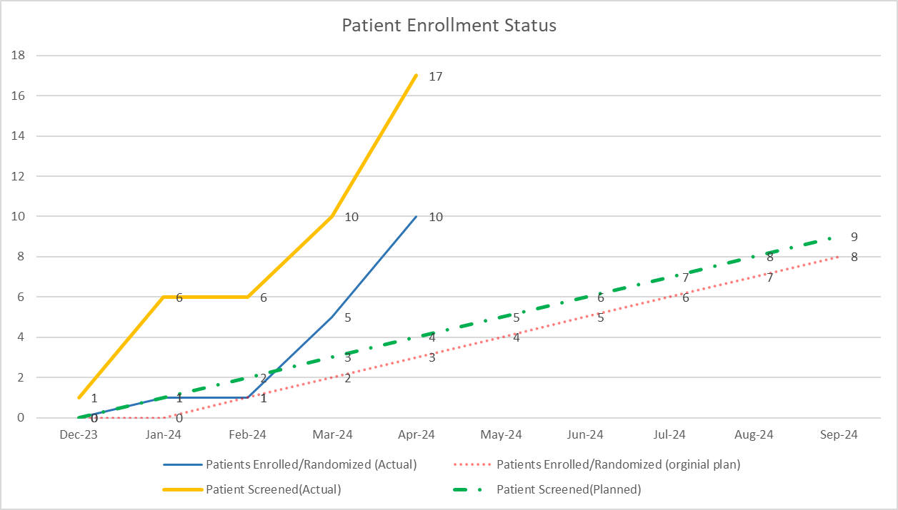


1368-0098 HS China recruitment information- 24Apr2024
Total Screened = 17
Total Randomized = 10
Total Screen failure = 2
Screen failure rate = 11.8%
Early discontinuation= 0%
 | Dec-23 | Jan-24 | Feb-24 | Mar-24 | Apr-24 | May-24 | Jun-24 | Jul-24 | Aug-24 | Sep-24
Plan screen | 0 | 1 | 2 | 3 | 4 | 5 | 6 | 7 | 8 | 9
Actual screen | 1 | 6 | 6 | 10 | 17
Plan randomization | 0 | 0 | 1 | 2 | 3 | 4 | 5 | 6 | 7 | 8
Actual randomization | 0 | 1 | 1 | 5 | 10
Notes:
6 patients screened by Feb2024, 4 patients screen failure due to TB positive and pending re-screen after CTP 2.0 approval (HGRAC approved, EC approved in 2 sites)

Slide 57

Ongoing:
BI 655130 (Anti-IL36R): Netherton Syndrome (NS)
2022 |  |  |  | 2023 |  |  |  | 2024 |  |  |  | 2025 |  |  |  | 2026 |  | 2027
Q1 | Q2 | Q3 | Q4 | Q1 | Q2 | Q3 | Q4 | Q1 | Q2 | Q3 | Q4 | Q1 | Q2 | Q3 | Q4 | Q1 Q2 | Q3 Q4 | Q1 Q2 | Q3 Q4
We are here
Jun2023
Aug 2024
Dec 2024
Jan 2028
Ph II/III N=39
Cross-over and OLE
Ph2/3- 1368.0104
FSS
LSS
LSLV Primary End Point
LSC
sNDA submission
Sep 2025
US Approv.
Best case: Mar 2026
Base Case: Jul 2026
NIS- 1368.0121
43 patients screened, 36 randomized as of Apr 15.
9 months acceleration. Last subject randomization by 09Sep2024.
No new screenings of adults. Only continue to enroll adolescents.
TLR is target in Feb 2025, BTD and pre-NDA HAI will be followed in Apr 2025.
Final decision on submission strategy: with w32 cutoff data submitted in Sep 2025, target approval in 2026
1368-0121 Natural course of disease
Readout Part 1
* Different submission scenarios are still under discussion
Jun2022
Dec 2022
19Jun 2023
May 2024
Aug 2024
Dec 2024
Sep 2025
May2026
Oct
2028
Jan
2028
Ph2/3-
1368.0104
Pre-IND
CTA Review + EC + HGRAC (6m)
Recruitment Window: ~18m (N=3/39)
Cross-over and OLE
CTA
1st SIV
China LSS
LSLV Primary End Point
LSC
(CN)
LSS
CN sNDA sub.
Sep 2025
CN sNDA approv.
Best case: Jul 2026
Base case: Dec 2026
LSC (G)
7 patients screened, 6 randomized (~15% of entire population, original committed 3 patients), 1 discontinued (withdraw by subject), continue to enroll adolescents.
CTP amendment (a 2-year OLE added) submitted on Feb 24, target approval in May
FSS: First subject screening
LSR: Last subject randomization
LSC: Last subject complete
OLE: open label extension
Notes:
Planning Meeting B on May 2-3.
HGRAC amendment approved. (25 screening, 15 randomization)
China recruitment will end 3-month earlier to facilitate the sample (NAb) exportation. – still pending confirm with CTL

Slide 58
Global Spesolimab NS – w32 submissions
DBL w16 – 27 Jan
CO w32–20 Aug
TLR w16 – 17 Feb
CTR w32–28 Jul
LSLV w52
LSC w52 30.12.25
CTR w52–18 May 26
LSLV w32– 21Apr
Val rep – 30 Jun
2025
2026
 |  | Apr | May | Jun | Jul | Aug | Sep | Oct | Nov | Dec | Jan | Feb | Mar | Apr | May | Jun | Jul | Aug | Sep
 | USA (Priority review)
 | USA (Standard review)
 | EU (Standard review)
 | Japan (Priority review 9m)
 | Japan (Standard review 12m)
 | China (Priority review 10m)
 | China (Standard review 15m)
BLA
D90 safety update
HAI placeholder
Approval best case
BTD request
Priority Application
Priority Designation
Potential extension of review
D120 safety update
Approval
Standard Designation
EU Rapp mtg
D 90 RSI
Approval base case
MAA
Slot 15.10.25
(best case)
Clock stop
Best case approcal
HAI placeholder
JNDA
JP Approval
“priority”
JNDA
JP Approval
“standard”
HAI placeholder
CDE sNDA
CN Approval
“priority”
BTD request
CDE sNDA
CN Approval
“standard”
Dec 26

Slide 59
Submission scenarios
Scenario 1
Week 16 data cut off
Scenario 2
Week 32 data cut off
Additional data available at w16 cut off:
W32 data from ~ 37 patients
W52 data from ~ 22 patients
W52 data from ~ 37 patients

Slide 60
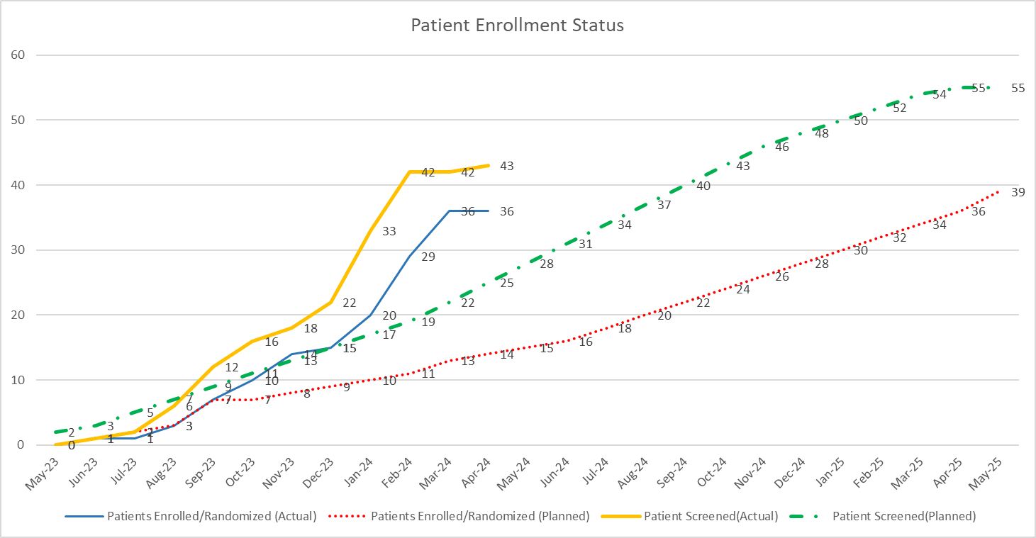
1368-0104 Global recruitment curve (as of 15Apr2024)
Total Screened = 43
Total Randomized = 36
Total Screen failure = 10
Screen failure rate = 23.2%
Early discontinuation=0
As of 15Apr, the enrollment curve is not revised in CTMS
Months | May-23 | Jun-23 | Jul-23 | Aug-23 | Sep-23 | Oct-23 | Nov-23 | Dec-23 | Jan-24 | Feb-24 | Mar-24 | Apr-24 | May-24 | Jun-24 | Jul-24 | Aug-24 | Sep-24 | Oct-24 | Nov-24 | Dec-24 | Jan-25 | Feb-25 | Mar-25 | Apr-25 | May-25
Patients Enrolled/Randomized (Actual) |  | 1 | 1 | 3 | 7 | 10 | 14 | 15 | 20 | 29 | 36 | 36
Patients Enrolled/Randomized (Planned) |  | 1 | 2 | 3 | 7 | 7 | 8 | 9 | 10 | 11 | 13 | 14 | 15 | 16 | 18 | 20 | 22 | 24 | 26 | 28 | 30 | 32 | 34 | 36 | 39
Patient Screened(Actual) |  | 1 | 2 | 6 | 12 | 16 | 18 | 22 | 27 | 42 | 42 | 43
Patient Screened(Planned) | 2 | 3 | 5 | 7 | 9 | 11 | 13 | 15 | 17 | 19 | 22 | 25 | 28 | 31 | 34 | 37 | 40 | 43 | 46 | 48 | 50 | 52 | 54 | 55 | 55

Slide 61
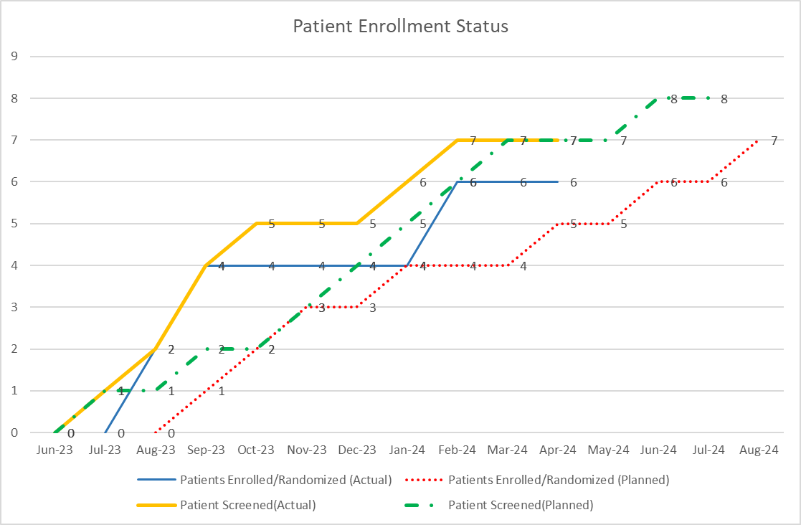
1368-0104 China recruitment curve (as of 15Apr2024)
China recruitment end date is under final confirmation with CTL
Total Screened = 7
Total Randomized = 6
Total Screen failure = 1
Screen failure rate = 14%
Early discontinuation=0
Original commitment 3 pts. achieved
Months | Jun-23 | Jul-23 | Aug-23 | Sep-23 | Oct-23 | Nov-23 | Dec-23 | Jan-24 | Feb-24 | Mar-24 | Apr-24 | May-24 | Jun-24 | Jul-24 | Aug-24
Patients Enrolled/Randomized (Actual) |  |  | 2 | 4 | 4 | 4 | 4 | 4 | 6 | 6 | 6
Patients Enrolled/Randomized (Planned) |  |  |  | 1 | 2 | 3 | 3 | 4 | 4 | 4 | 5 | 5 | 6 | 6 | 7
Patient Screened(Actual) |  | 1 | 2 | 4 | 5 | 5 | 5 | 6 | 7 | 7 | 7
Patient Screened(Planned) |  | 1 | 1 | 2 | 2 | 3 | 4 | 5 | 6 | 7 | 7 | 7 | 8 | 8

Slide 62
Ongoing:
BI 655130 (Anti-IL36R): Pyoderma Gangrenosum (PG)
2023 |  |  |  | 2024 |  |  |  | 2025 |  |  |  | 2026 |  |  |  | 2027 |  |  |  | 2028 |  |  |  | 2029
Q1 | Q2 | Q3 | Q4 | Q1 | Q2 | Q3 | Q4 | Q1 | Q2 | Q3 | Q4 | Q1 | Q2 | Q3 | Q4 | Q1 | Q2 | Q3 | Q4 | Q1 | Q2 | Q3 | Q4 | Q1 | Q2 | Q3 | Q4
We are here
Q1 2024
US request for preliminary advice regarding Breakthrough Therapy Designation (PBTDAR) submitted 30 Nov – pending response
Target date for 'first patient randomized' was shifted from Nov2024 to 31Mar2025, due to a HPBU budget reduction target for 2024.
ECR (FSS-LSC)
ECR:1368.0134
IA results
FDA Meeting/WRO
Mar 2024
Jul 2024
Feb2025
Oct 2025
Oct 2026
Ph3 Pivotal 1368-0140
FSS-LSR
LSR-LSC
CTA
BLA submission
Apr 2027
US sNDA approval
Sep 2027
Timeline to be updated
Jan2024
Jul
Jan 2025
Ph3 Pivotal 1368-0140
Pre-IND
CTA Review + EC + HGRAC
1368-0140 recruit. window: ~8m
LSR-LSC
CN sNDA sub
Apr 2027
CN sNDA approval
Jul 2028
Meeting
request
CTA
1st SIV
Pre-IND meeting request submission on Feb 1. Feedback from CDE clinical dept was received: most comments are general without additional actions; China team is requesting to add Chinse expert to global adjudication committee.
Feasibility Check for 16 sites completed,.
ECR: External collaborative research
HAI: Health authority interaction
FSS: First subject screening
LSS: Last subject screening
LSC: Last subject complete
LSR: Last subject randomization
Notes:
1.Our target date for 'first patient randomized' was shifted to 31Mar2025. Background: At the beginning of the year, the HPBU was given a budget reduction target for this year. As you can imagine, finding savings that can still be realized in the very year you are in, is not easy and limits one's options to delaying the start of activities rather than stopping ongoing ones. Thus, TA Infl Medicine leadership identified our PG program as one of the activities to propose for 2024 budget reductions. Our PG program featured a 2024 budget of 10.5 Mio€ . This was based on a PhII/III start mid-year, which we (optimistically) estimated when the 2024 budget was created. Shifting the FPR to the November date realized some savings, shifting it further to 31Mar2025 now realizes saving of ~9 Mio€. This was proposed to and endorsed by HPBU leadership - who in turn will present the overall budget adjustments to the board soon. Bottom line: This shift does not represent a loss of faith in or support of the PG program, but a reaction to the budget adjustments our most senior leadership deemed necessary to accommodate the business needs of the company.
2.Our target date for RoFD was shifted from April to June. Background: While preparing for the RoFD presentation in April, we realized that it would be prudent to shift this presentation to the next HPSC in order to fully incorporate Health Authority feedback and allow the overall presentation to be more thoroughly aligned cross-functionally. As the presentation itself is not on the critical path to our clinical trial, this shift did not change our overall timelines. It's of course unfortunate when deadline shift on rather short notice. The efforts put into this milestone will not be in vain but will still be part of the RoFD presentation and the PG program. The shift was pre-aligned with and endorsed by TA leadership.
16 sites contacted, 15 interested, 1 rejected. Pending for an on-site visit with Prof. Zheng Jie from Ruijin Hospital.
Regarding comments on Chinese adjudication committee, LPT propose to involve Chinese experts into the global adjudication committee instead of set up separate China adjudication committee in MRCT. Local evidence lead has engaged with global team on this topic before and LPT will discuss with global team on this further

Slide 63
Ongoing:
BI 655130 (Anti-IL36R): Pyoderma Gangrenosum (PG) - before update for reference
2023 |  |  |  | 2024 |  |  |  | 2025 |  |  |  | 2026 |  |  |  | 2027 |  |  |  | 2028 |  |  |  | 2029
Q1 | Q2 | Q3 | Q4 | Q1 | Q2 | Q3 | Q4 | Q1 | Q2 | Q3 | Q4 | Q1 | Q2 | Q3 | Q4 | Q1 | Q2 | Q3 | Q4 | Q1 | Q2 | Q3 | Q4 | Q1 | Q2 | Q3 | Q4
We are here
Q1 2024
US request for preliminary advice regarding Breakthrough Therapy Designation (PBTDAR) submitted 30 Nov – pending response
ECR (FSS-LSC)
ECR:1368.0134
IA results
FDA Meeting/WRO
Mar 2024
Jul 2024
Oct 2024
Oct 2025
Oct 2026
Ph3 Pivotal 1368-0140
FSS-LSR
LSR-LSC
CTA
BLA submission
Mar 2027
US sNDA approval
Sep 2027
Jan2024
Jul
Jan 2025
Ph3 Pivotal 1368-0140
Pre-IND
CTA Review + EC + HGRAC
1368-0140 recruit. window: ~8m
LSR-LSC
CN sNDA sub
Apr 2027
CN sNDA approval
Jul 2028
Meeting
request
CTA
1st SIV
Pre-IND meeting request submission on Feb 1.
Feasibility Check ongoing.
ECR: External collaborative research
HAI: Health authority interaction
FSS: First subject screening
LSS: Last subject screening
LSC: Last subject complete
LSR: Last subject randomization

Slide 64
Inflammation product Overview
Substance/ MOA/Formulation | Indication | Study type/Global Status (Study no.: FPI-LPO, CTR) | China Dev. Strat. | Current Status | Next Mile-stone | Key Updates
Spesolimab EAP | GPP | EAP(1368-0077) | Global | CTR | close | CTR is finalized on 27Mar 2024 China Investigator meeting planned on May10 2024. Site close out in process.
Experience of Adults with Generalized Pustular Psoriasis (GPP) or Palmoplantar Pustulosis (PPP) | GPP/PPP | NIS (1368-0058) | Global (Fully out- sourced) | DBL | CTR | Patent recruitment in China has ceased om 20 Dec2022 , final recruitment： GPP survey/interview : 9/5, PPP survey/interview:5/3 Interim analysis posted at 2023 WCD conference Follow up the CTR from global
SCRIPTOR Study- Retrospective Chart Review | GPP | NIS(1368-0085) | Global (Fully out- sourced) | SSU | FPI | Global HAMA decide to stop SCRIPTOR study in China, due to budget increase and timeline delay caused by data export restrictions from CAC (中国国家互联网信息办公室) With resolutions, China team will continue to seek the study restarts China legal team confirmed that the data export issue has been resolved. current timeline suggest that continue this study may be a better choice than a new study
Exploration of the pathogenesis of GPP and PV​ | GPP/PV​ | IIS(1368-0133) (Nov2023-Apr2024, Jun2024) | China alone​ | FSI | LSI | HGRAC online approval on Oct 30th, wet-ink obtained on Apr 9th Enrolment: GPP+PV: tissue 5/4; blood 4/4 GPP: tissue 2/4; blood 2/4 PV: tissue 4/4; blood 2/4
Spesolimab​ | PG&HS&NS​ | ECR​ (2023-2027)​ | China alone​ | PEC endorse​ | Global endorse​ | PEC endorsed PG and HS at PEC of Dec 2023, PEC endorsement for NS is pending. Feasibility check completed, will submit for PEC endorsement in Apr2024
CAC (the Cyberspace Administration of China)中国国家互联网信息办公室; PV: Psoriasis Vulgaris

Slide 65
Back Up

Slide 66
TRPA-1 Ph2 study design

Slide 67
Mitigation status update of FVC data missing
No | Mitigation | Status
1 | Trial team to release the “Dear investigator letter” and newsletter to clarify the visit procedure requirement after treatment early discontinued. | Completed
2 | Refresh training for CRA, Investigators/CRC to highlight the importance of FVC data per visit. | Completed
3 | CTM track the treatment discontinued subjects with CRAs to follow up weekly | Tracker Completed
4 | Site staffs refresh training for AE management and encourage keeping subject treatment with closely follow up. | Completed
5 | On site visit by CD&O for high risk sites (5 sites identified and planned within one month) | Completed
6 | FVC test reimbursement /ICF update | Completed
7 | commercial drug donation for placebo group initiated | Ongoing (contract negotiation ongoing)
8 | Trial Team update the MQR Plan to include the monitoring of QTL*regarding FVC data in IQRMP and deliver the risk/issue to CTMs. | Completed
9 | CTL/TSTAT to set up the output for FVC data per visit monitoring and shared with team monthly. | Completed
10 | CTL/SML provide the analysis FVC data report for CRA team weekly and create the tracker with planned visit after treatment discontinued for CRA team closely follow up. | Completed
11 | CTL/SML update TLMM* to specific the monitoring details for treatment discontinued and highlight data entry timeline and pay more attention on data entry oversight. | Completed

Slide 68
Early EOT pts update since last meeting (9 Oct 2023)
Below two new EOT subject status details
Subject Number | Update on 28Aug2023 | Update on 8 Oct 2023
1156031005 | 7.26患者自诉服用试验药胃不舒服（7.10）并伴有稀便，自行停药（7.15-8.1）， 8.2来院进行剂量调整访视（降低至100mg），大约8.5反馈胃还是不舒服伴有恶心和呕吐（8.2检查肝酶正常），患者自行停药至今，并表示想居家修养一些时间再到医院就诊。 8.21研究者表示将再次联系患者确认情况。 下次计划访视V7（2023-09-15），研究者和患者保持联系，请患者尽可能回院按照计划完成V7访视 | 于2023-09-12 完成EOT 访视，目前表示可回院进行后续随访
1156005015 | NA | 该受试者因居住地变更，离医院3小时车程，患者状态较差需随身携带制氧机； 无法回院进行常规随访和肺功能检查，于2023-09-15登记EOT
No other potential early EOT pts by now
Subject 1156031004 who discontinued on 29 June 2023 potentially lost to follow up

